Slide 1
EART 28202 : Structural Geology
Class 9 : Extensional Tectonic Regimes
Notes:
In the notes panes to these slides there are numerous references (figure credits and further reading). If the reference is incomplete it refers to the references stated in the reading list on the last slide
With regard to figures in this PowerPoint file, many will be subject to copyright restrictions. I don’t care about you using any of the figures/photos that are mine (Steve Covey-Crump), although a credit would be nice, but take care to comply with copyright restrictions if you reuse any that are not

Slide 2
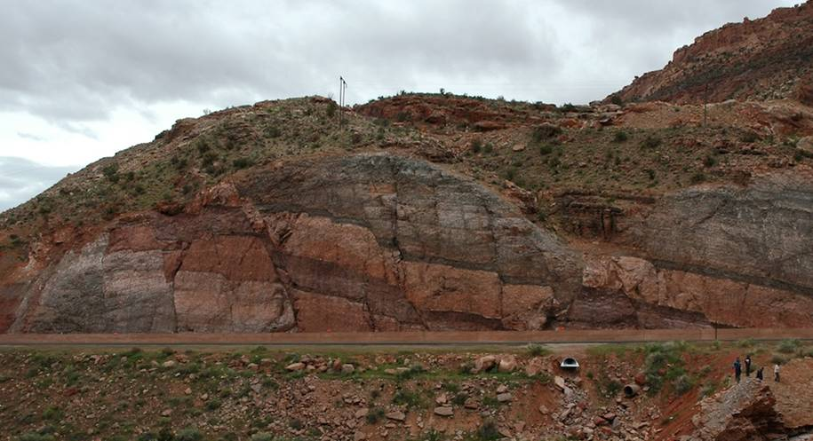
Extensional tectonic regimes
In the mid-1980s, shortly after the period when the orogenic significance of thrust systems became more widely appreciated, a similar breakthrough in understanding was achieved for extensional fault systems
This led to a major re-evaluation of the importance of extensional phases within orogenic cycles, and to a new understanding of the interrelationships between the structures that are found within extensional terrains
Many of the world’s hydrocarbon reservoirs are located in extensional terrains, and so many of the techniques used to unravel the geometry of extensional fault systems were developed within that industry
Extensional faults in the footwall of the Moab Fault, Utah
Notes:
Extensional deformation = stretching
Photo from Fossen (one of the extra figures on the web-site for the book, folk.uib.no/nglhe/StructuralGeoBook.html)

Slide 3
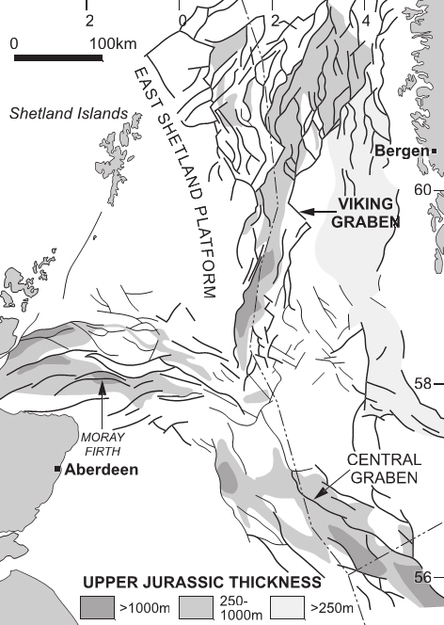
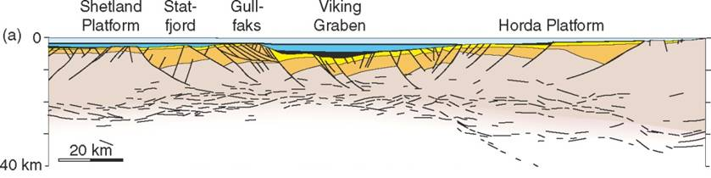
Rifts
The most obvious regional scale extensional tectonic system is the rift
Rifting is usually some combination of
  active rifting: driven by rising hot mantle material that causes crustal doming and thereby generates tensile stresses, and
  passive rifting: developed in response to far-field stresses related to plate movement
HORDA Platform
WNW
ENE
The North Sea rift system formed in two E-W extensional episodes, one in the Permo-Triassic and the other in the Late Jurassic
Notes:
Active rifting arises from stretching over the top of a growing dome induced by, for example, an underlying thermal plume. Passive rifting arises from the tensional stresses that are set up by plates moving apart (such stresses can also arise locally in both contractional and strike-slip tectonic settings). The distinction between active and passive rifting is conceptually significant in setting up geophysical models of extension, but it is rather forced because there are active and passive elements within each rifting environment, e.g., in passive rifting, extension may lead to doming as relatively hot, deep rocks are brought nearer to the surface, but this doming is assigned as a secondary process. For this reason, some favour a classification of rifting that is tied more closely to the tectonic setting (see Merle, 2011, Tectonophysics 513: 88-95, https://doi.org/10.1016/j.tecto.2011.10.004)
Figure left (from Fossen, p.390, but derived from Odinsen et al., 2000, Geological Society, London, Special Publications 167: 41-57, Fig.2, https://doi.org/10.1144/GSL.SP.2000.167.01.03): a WNW-ESE section across the Viking Graben. The orange-coloured units are Permo-Triassic, the yellow is Jurassic, the black and deep blue is Cretaceous, and the light blue is Cenozoic. Note the preponderance of listric faults (ones that dip more shallowly with increasing depth), and the thickening of the sedimentary packages towards the faults in the hanging walls
Figure right from Cowie et al., 2005, Earth & Planetary Science Letters 234: 401-419, https://doi.org/10.1016/j.epsl.2005.01.039

Slide 4
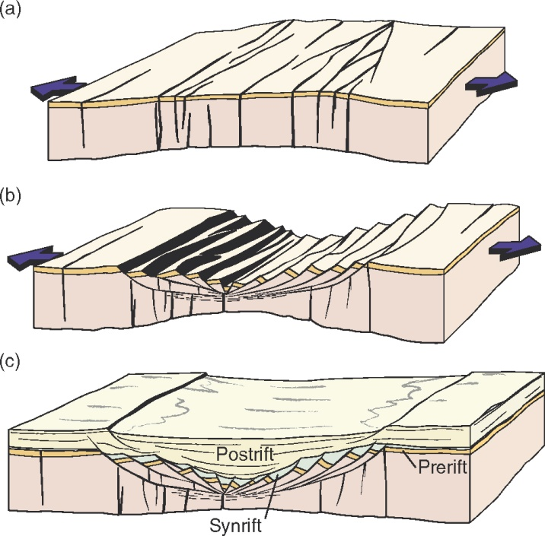
Rift development
Rifting occurs in three phases
Initial phase: rifting as a result of large-scale crustal doming; steep fracture systems form; possible intrusion of magma generated at depth
Main stretching phase: formation of major faults/fault blocks that accommodate the crustal thinning
Late subsidence phase: cooling and basin deepening once stretching has ceased; fault movement is mostly limited to that induced by differential compaction of the sedimentary succession
The extensional development of the rift influences its sedimentary record: syn-rift sediments show thickness variations across faults (hanging wall thickening and footwall thinning/non-deposition); the post-rift sequence depends upon the geometry of the fault blocks and the extent of thermal subsidence
Notes:
Figure (from Fossen, p.388) showing the development of a rift system

Slide 5
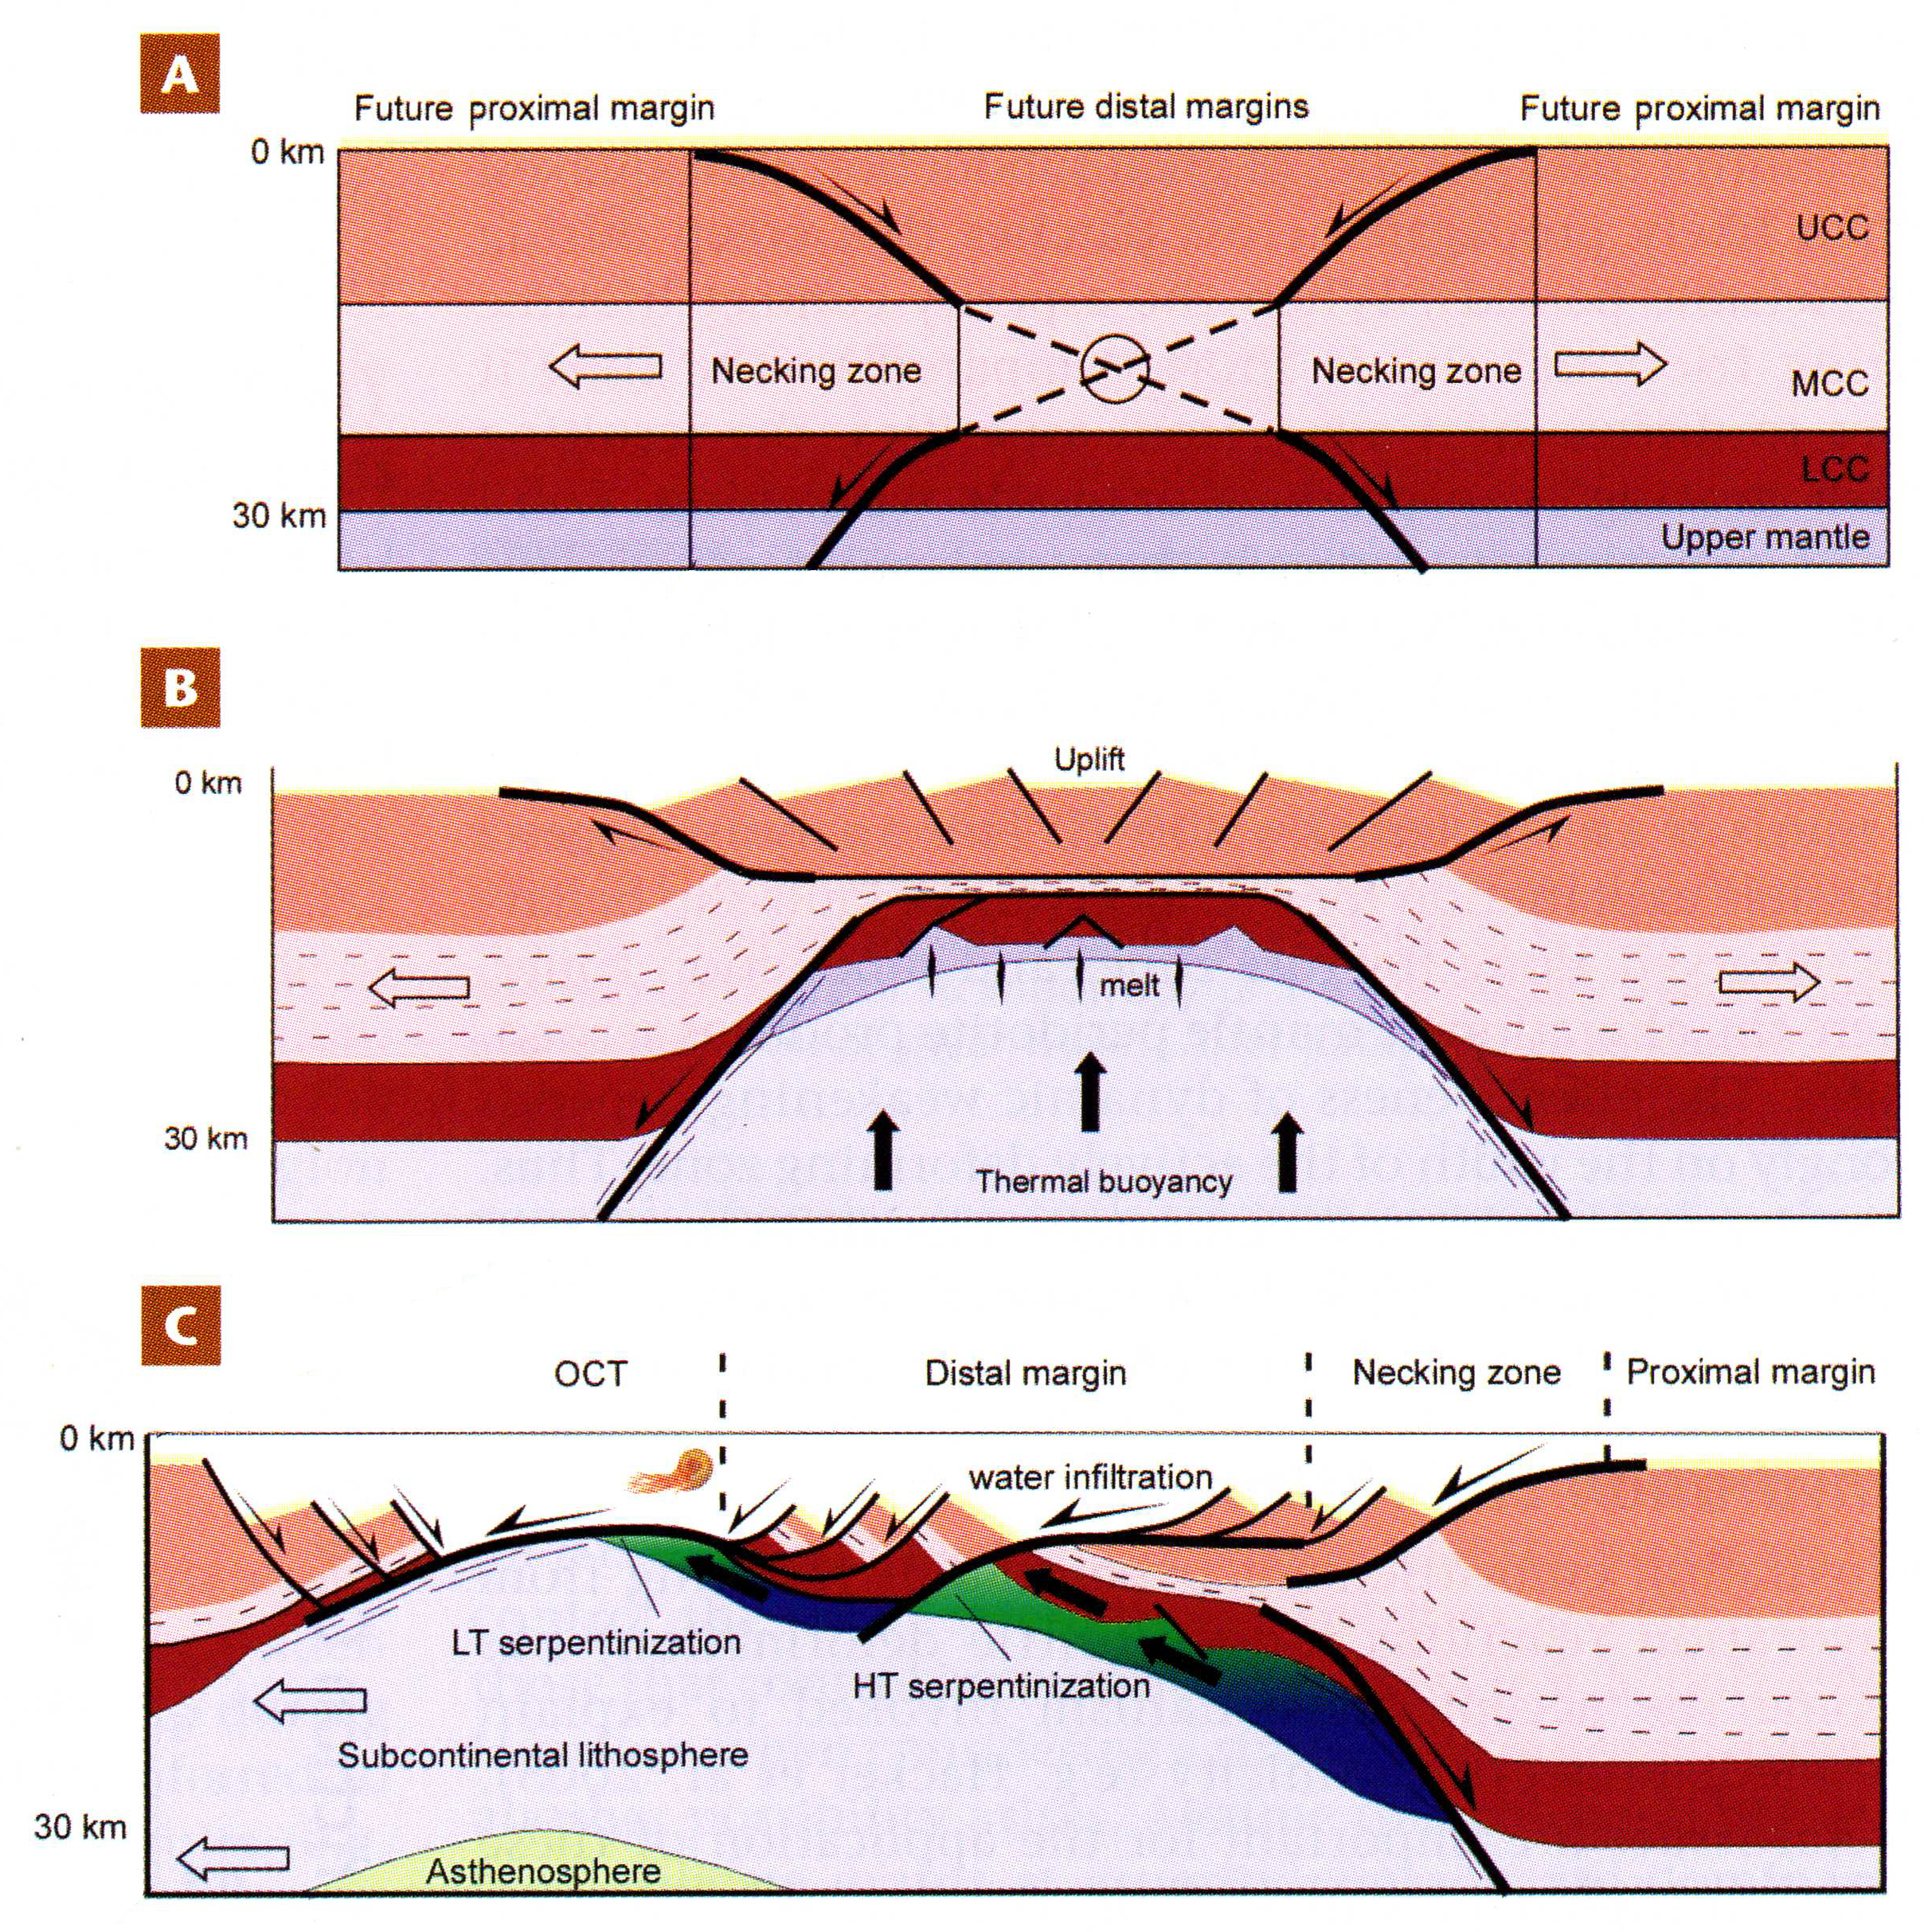
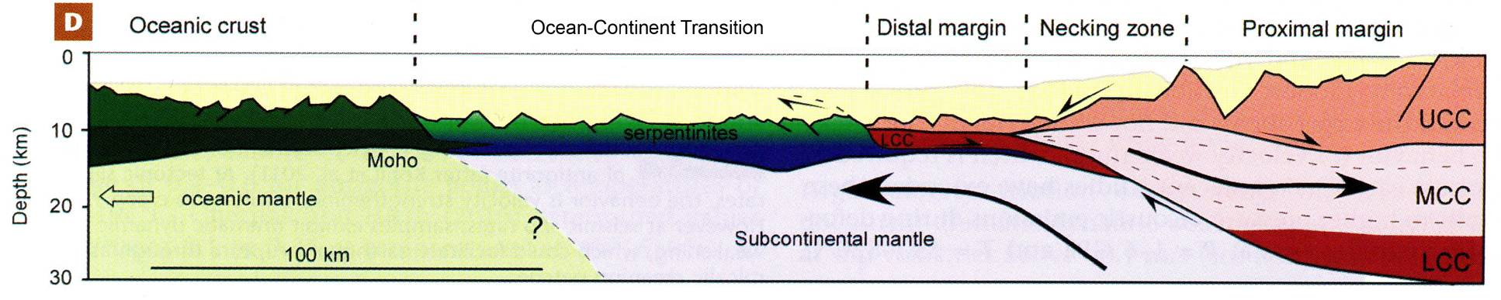
Rifting to ocean crust formation
If a continental rift extends far enough, the crust splits and is replaced by oceanic crust so that a passive margin is established on each side of the rift
= 300%
Oceanic crust initiates when L / L₀ ~ 3
length
initial length
Notes:
The figures illustrate current understanding of how crustal thinning proceeds to the point where oceanic crust forms. (A) Thinning is initially accommodated by slip along conjugate shear zones that cut through the upper crust and lower crust with the middle crust between them deforming by ductile flow. (B) The upper mantle is thinned and replaced by deeper, hotter mantle that is intruded by mafic magmas. (C) Faults cut from the surface into the mantle, and seawater infiltrates these faults thereby initiating serpentinization. Serpentinization weakens the upper mantle layer promoting strain localization and allowing the normal faults to root at low angle. Ongoing extension leads to buoyant flow of the partially serpentinized mantle along the low angle detachment faults (see Slide 10), resulting (D) in horizontal stretching of the subcontinental mantle at the seafloor
Figures from Hirth & Guillot, 2013, Elements 9: 107-113, https://doi.org/10.2113/gselements.9.2.107

Slide 6
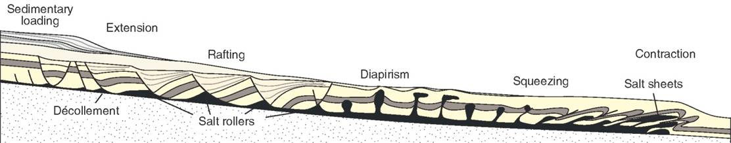
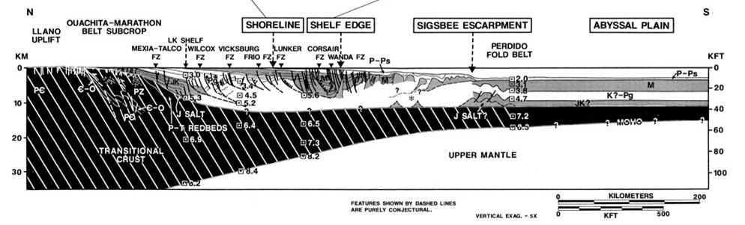
Passive margins
Fault movement on well-developed passive margins is mostly gravity-driven and occurs on faults that merge down to a décollement horizon (typically salt or over-pressured mudstones)
Texas continental shelf and schematic diagram of a passive margin with salt detachment
Notes:
I have positioned the schematic section above so that it approximately matches the equivalent structures in the real section from the Texas continental shelf below
Figure top from Fossen, p.436
Figure bottom from Twiss & Moores, p.106

Slide 7
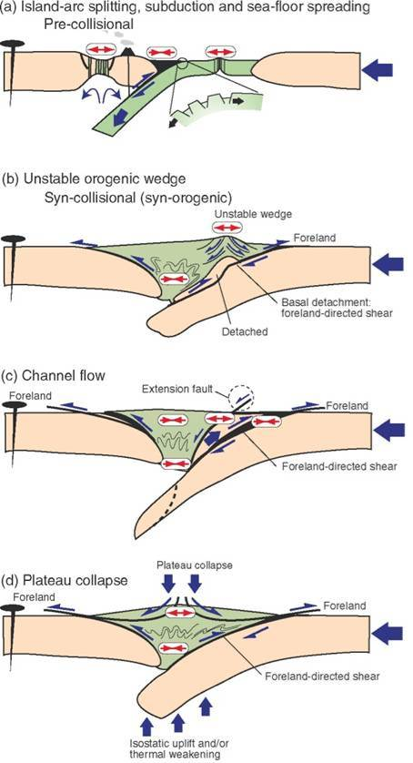
Extension in active contractional orogenic belts
Extension is not restricted to rifts and passive margins – some of the most impressive extensional faults are to be found in contractional orogenic belts
While an ocean still exists between two converging continents, extension occurs by back-arc rifting and also in the outer arc of the oceanic plate where it bends on entering the subduction zone
Normal faults may form in the orogenic wedge if it is over-thickened by incorporation of a basement slice
A detached and heated basement slice may be buoyant enough to ascend, bounded by a thrust on its lower side and by a normal fault on its upper side (channel flow)
Heating of thickened crust may lead to sufficient weakening for it to collapse under its own weight (gravitational orogenic collapse)
Notes:
On unstable (over-thickened) wedges see Class 8 Slide 44
Figure from Fossen, p.393

Slide 8
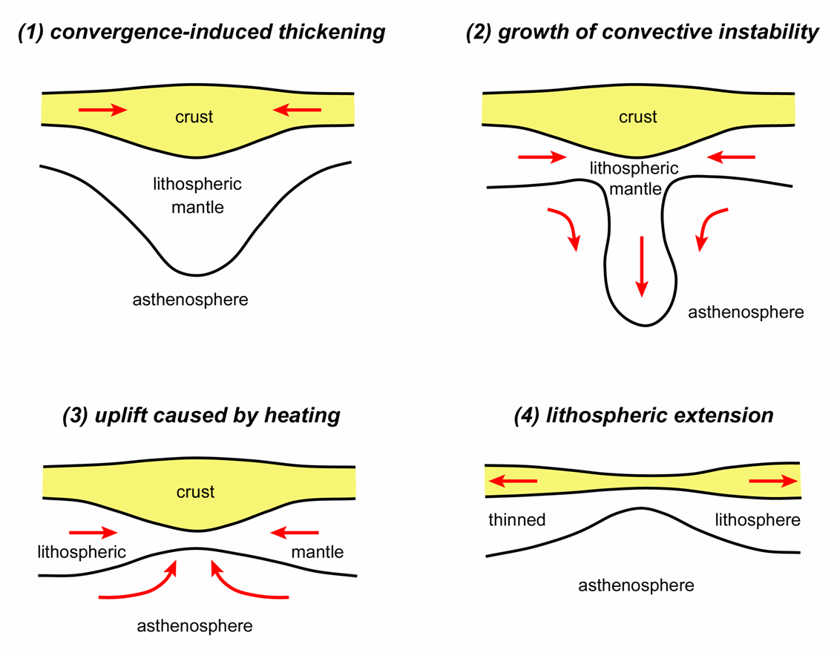
Post-orogenic collapse
At the end of a contractional orogeny the relatively cool lithospheric mantle root under the orogenic belt, together with phase transitions such as eclogitization, may make that root sufficiently dense for it to delaminate and sink into the deeper mantle. Replacement by hot material leads to regional uplift and gravitational collapse in the crust above
Extension induced by delamination may use the thrusts formed previously during collision (inversion), or may involve the formation of new normal faults
The emplacement of post-orogenic minor intrusions (typically lamprophyres derived from metasomatized sub-continental lithospheric mantle) takes advantage of this extension
Notes:
Figure (redrawn by Steve Covey-Crump from Molnar et al., 1998, Geophysical Journal International 133: 568-584, https://doi.org/10.1046/j.1365-246X.1998.00510.x): a cartoon representing the life and times of a contractional orogenic belt: (1) initial lithospheric thickening during collision of relatively cool, strong lithosphere, (2) delamination of the lithospheric root occurs because it is denser than the underlying asthenosphere, (3) uplift ensues as warm asthenosphere replaces the cool lithospheric root, (4) the crust heats up and eventually becomes too weak to support its own weight, and so undergoes gravitational collapse
Delamination of this kind is an example of a Rayleigh-Taylor convective instability (an instability that occurs in a convecting system when a dense layer overlies a less dense layer). The switch from dominantly contractional to dominantly extensional deformation at the end of a collisional orogeny has been successfully modelled as a Rayleigh-Taylor instability by geophysicists (see Houseman & Molnar, 1997, Geophysical Journal International 128: 125-150, https://doi.org/10.1111/j.1365-246X.1997.tb04075.x; Molnar et al., 1998, Geophysical Journal International 133: 568-584, https://doi.org/10.1046/j.1365-246X.1998.00510.x; Neil & Houseman, 1999, Geophysical Journal International 138: 89-107, https://doi.org/10.1046/j.1365-246x.1999.00841.x)
The word ‘inversion’ arises because thrusts formed during contraction are reactivated as normal faults, that is, the sense of movement on the fault system is reversed. On ‘inversion’ in the opposite sense (thrusts using pre-existing extensional faults rather than extensional faults using pre-existing thrusts), see Slide 20
Lamprophyre is a field term used to describe hypabyssal igneous rocks of wide-ranging composition that are typically alkali-rich and hydrous. They are commonly the crystallization products of very deeply derived magmas. Those who went on the Scotland Easter field course saw examples of post-orogenic lamprophyric intrusions. In the Scottish Caledonides, these lamprophyres, often ignored because they are only small intrusions, actually collectively account for 10-20% of the total Caledonian magmatism

Slide 9
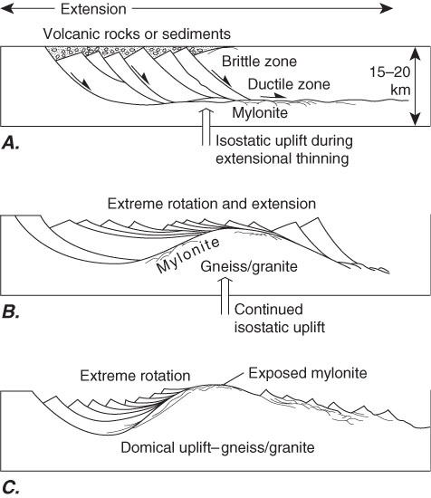
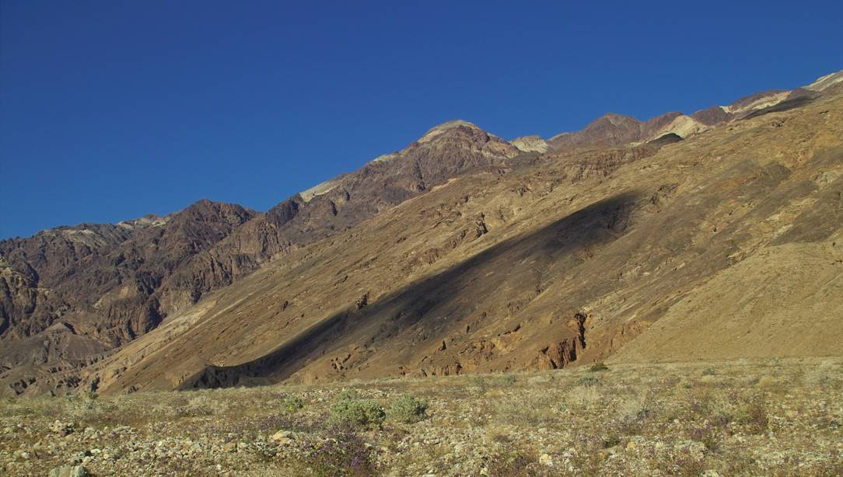
Metamorphic core complexes
During extreme extension (100%+), thinning and isostatic compensation elevates deeper levels of the crust. Eventually, the high-grade footwall rocks may be exposed at the Earth’s surface
These are metamorphic core complexes, and they are particularly well-developed in the Basin-and-Range Province of western USA
The isostatic uplift gives the main normal fault a dome-like shape often described as a turtle-back
A key feature is the overprinting of ductile fabrics by brittle structures
Badwater turtle-back, Death Valley
Notes:
The role of isostasy in the development of metamorphic core complexes is discussed by Wernicke & Axen, 1988, Geology 16: 848-851, https://doi.org/10.1130/0091-7613(1988)016<0848:OTROII>2.3.CO;2. For reviews of the formation of metamorphic core complexes, see Whitney et al., 2013, Geological Society of America Bulletin 125: 273-298, https://doi.org/10.1130/B30754.1, and Platt et al., 2015, Journal of the Geological Society, London 172: 9-27, https://doi.org/10.1144/jgs2014-036
The overprinting of ductile fabrics by brittle ones is because deeper, high temperature deformation in the shear zones is replaced by brittle fault displacement as the fault is unroofed (brought closer to the surface)
Photo bottom left (by Brennan Jordan, www.pbase.com/image/41768715): the Badwater fault separates Neogene and Quaternary volcanics and sediments above (the darker red-brown units on the photo) from predominantly Precambrian mylonites below (the buff-brown units on the photo). For an account of the Badwater and other Death Valley turtle-backs, see Miller & Pavlis, 2005, Earth-Science Reviews 73: 115-138, https://doi.org/10.1016/j.earscirev.2005.04.007
Figure top right from Twiss & Moores, p.102

Slide 10
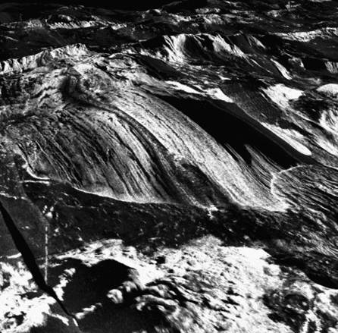
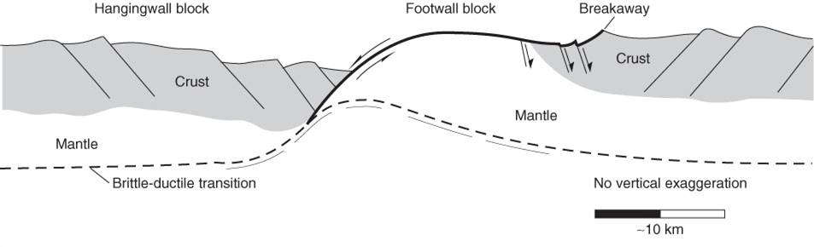
Oceanic core complexes
Core complexes have also been found in the axial valley of slow spreading mid-ocean ridges, where they expose lower crustal gabbros and upper mantle peridotites on the ocean floor
A well-developed lineation (megamullions) is developed over distances of 10 km+ parallel to the extension direction on the domed surface of the footwall block
Slip is initiated on high angle (65°) normal faults; on most of these, slip ceases at relatively small displacements, but on some the formation of talc
during temporary periods of waning magmatism allows runaway slip, which in turn leads to footwall doming through flexural unloading
Notes:
Image top right (from McLeod et al., 2009, Earth and Planetary Science Letters 287: 333-344, https://doi.org/10.1016/j.epsl.2009.08.016): a sidescan sonar image overlain on to an image of the sea floor bathymetry – the lineated surface is ~10 km across. Location: 13°19´N on the Mid-Atlantic Ridge
Figure bottom right from Twiss & Moores, p.104

Slide 11
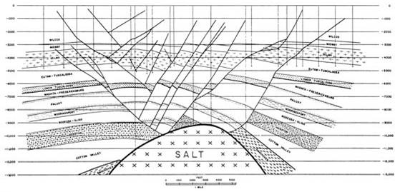
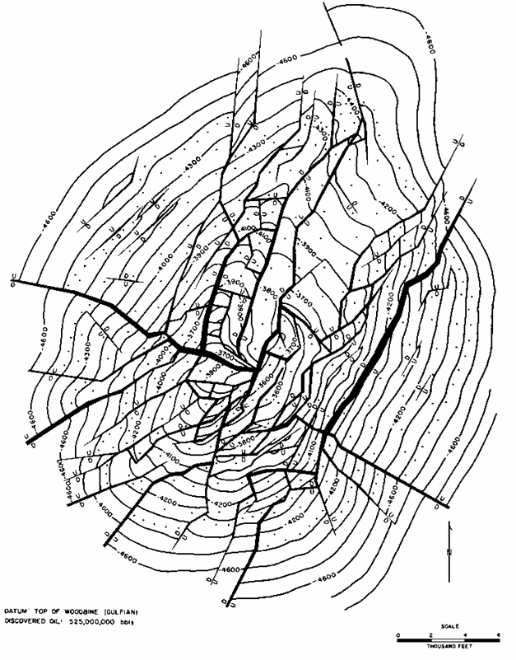
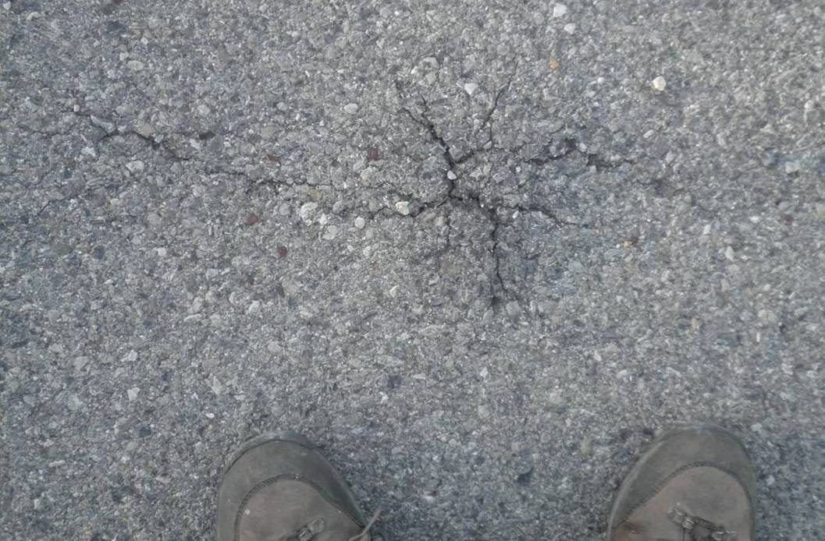
Local extension above domes/magma chambers
Above structural domes (e.g., over a rising salt dome or a mantle plume), the uplifted and domed units are put into a state of circumferential extension
The response is a set of normal faults that radiate out from a central point with displacement on these faults decreasing outwards
Radial fractures within tarmac
Hawkins salt dome
Notes:
The formation of radial faults above diapirs is mechanically quite complex: some of the faults result from extension as the cover rocks dome and stretch above the diapir, whereas others arise from the stretching imposed as the stem of the diapir attempts to widen. For a discussion of these points, see Coleman et al., 2018, Geology 46: 655-658, https://doi.org/10.1130/G40338.1
Figure top right (from Twiss & Moores, p.97): section of a normal fault system above a salt dome
Figure bottom right (from Parker & McDowell, 1951, American Association of Petroleum Geologists Bulletin 35: 2076-2094, https://doi.org/10.1306/3D934322-16B1-11D7-8645000102C1865D, but ultimately derived from Wendlandt et al., 1946, American Association of Petroleum Geologists Bulletin 30: 1830-1856, https://doi.org/10.1306/3D933884-16B1-11D7-8645000102C1865D): radial fault patterns over the Hawkins salt dome, Wood County, Texas – stratum contours on the top of the Woodbine Shale show the shape of the dome
Photo bottom left (Steve Covey-Crump): radial fractures above a “bump” in the road surface, Senez, near Barrême, SE France. Extension has presumably arisen from the flow of tarmac that has been laid down over a large stone in the road foundations

Slide 12
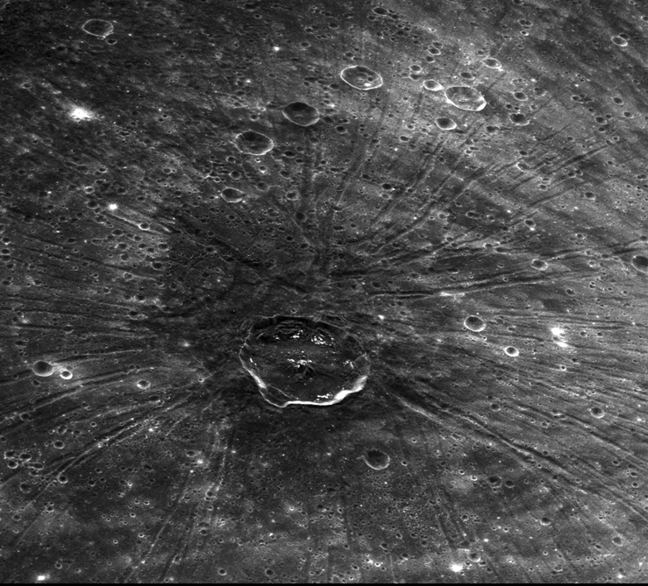
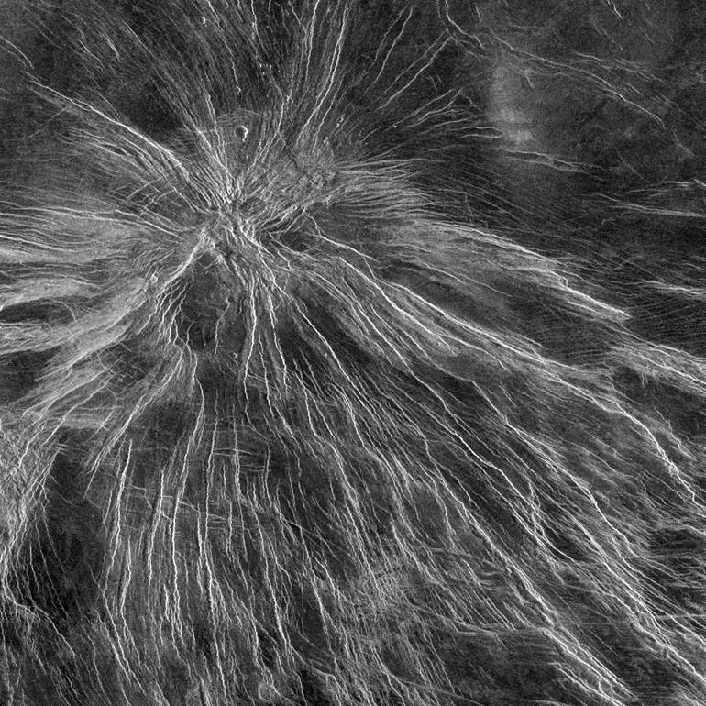
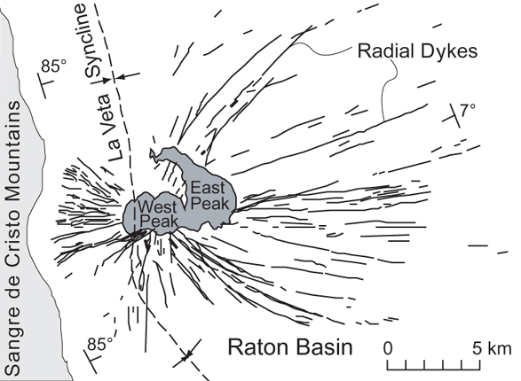
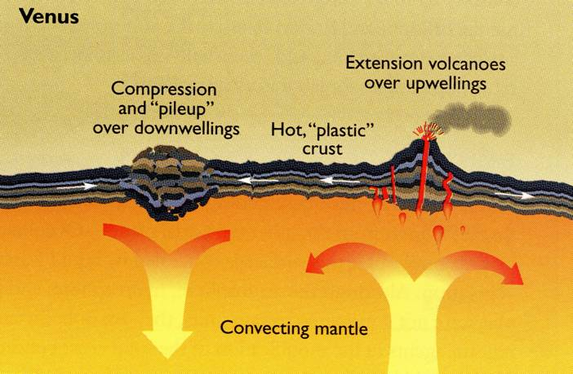
Local extension above domes/magma chambers 2
Pantheon Fossae, Caloris Basin, Mercury
Devana Chasma on Venus
Radial dykes, Spanish Peaks, SE Colorado
Notes:
These images point to the fact that radial fracture patterns above domes actually have a range of different origins
Image top left (from http://www.planetary.org/multimedia/space-images/mercury/20140126_messenger_pantheon_fossae.html): Messenger image. In the current interpretation, the 40 km diameter impact crater, Apollodorus, near the centre of the radiating fracture set had nothing to do with the formation of the Pantheon Fossae fractures. Pantheon Fossae lies near the centre of the 1500 km diameter Caloris impact basin. It is thought that lateral crustal flow (from surrounding areas towards the centre of the basin), driven by a difference in vertical stress between the area underlying this excavated impact basin (low stress) and the area surrounding it (high stress), led to doming in the centre of the basin and hence to the radial fracturing (see Watters et al., 2005, Geology 33: 669-672, https://doi.org/10.1130/G21678AR.1; Watters et al., 2009, Earth and Planetary Science Letters 285: 309-319, https://doi.org/10.1016/j.epsl.2009.03.040; Klimczak et al., 2010, Icarus 209: 262-270, https://doi.org/10.1016/j.icarus.2010.04.014; Klimczak et al., 2013, Journal of Geophysical Research: Planets 118: 2030-2044, https://doi.org/10.1002/jgre.20157)
Figure bottom left (adapted by Steve Covey-Crump from Muller & Pollard, 1977, Pure and Applied Geophysics 115: 69-85, https://doi.org/10.1007/BF01637098). The Spanish Peaks radial dyke swarm was the subject of a classic stress analysis by Odé, 1957, Geological Society of America Bulletin 68: 567-576, https://doi.org/10.1130/0016-7606(1957)68[567:MAOTDP]2.0.CO;2. The Muller & Pollard paper refines this analysis. Radial dyke swarms reflect the way that pressurized magma within a central magma chamber exploits radial fractures (and potentially assists in the fracturing process itself)
Photo top right (from solarsystem.nasa.gov/multimedia/gallery/nssdc_mgn_c130s279.jpg): Magellan radar image. On Devana Chasma, see Kiefer & Swafford, 2006, Journal of Structural Geology 28: 2144-2155, https://doi.org/10.1016/j.jsg.2005.12.002. This is a volcanic edifice
Figure bottom right from Beatty et al. (editors), 1999, The New Solar System (4th edition), Cambridge University Press, p.169. The tectonics of Venus are currently rather poorly understood and the picture presented in this figure is undoubtedly over-simplified. It is not relevant for the point made on this slide (that radial extensional fractures form above domes) but for those interested in a more refined model of tectonics on Venus, see Harris & Bédard, 2015, Geological Society, London, Special Publications 401: 327-356, https://doi.org/10.1144/SP401.9. The tectonics of Venus are considered by some to provide an indication of the tectonic processes that were operating on Earth in the early Precambrian before plate tectonics in its present form initiated

Slide 13

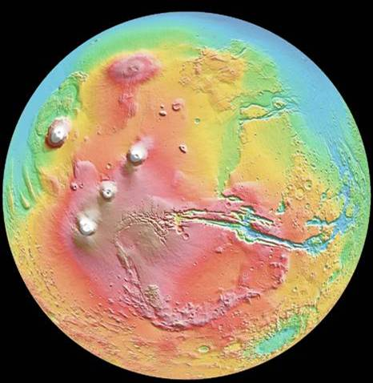
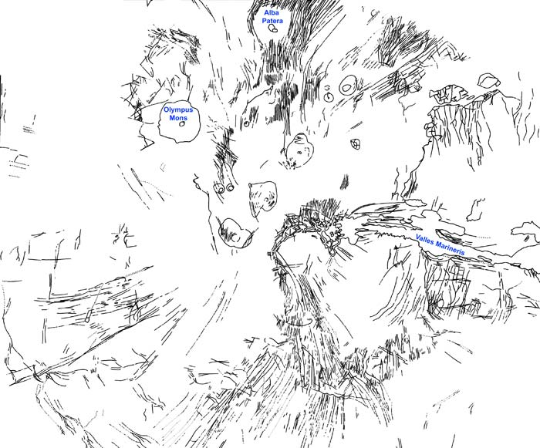
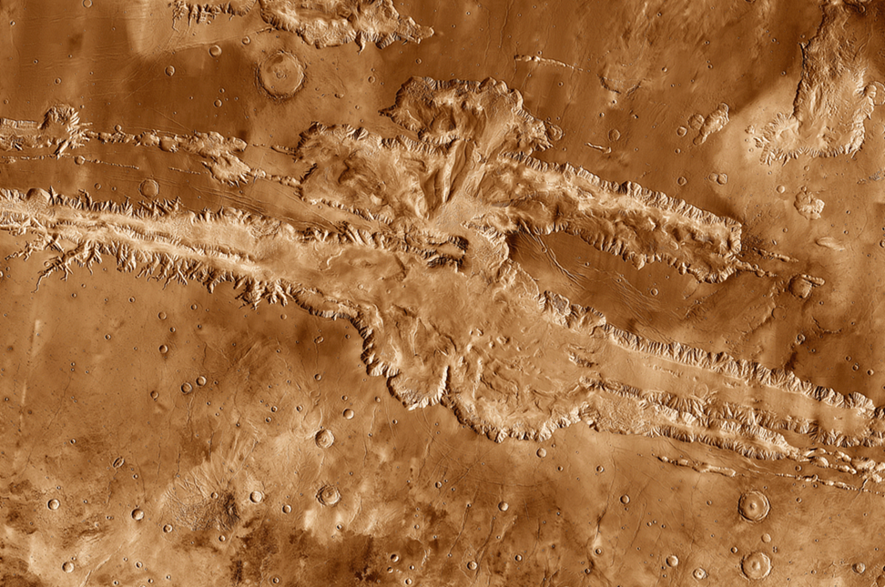
Local extension around loaded lithosphere
Radial extension fractures around Tharsis
The radial extensional fractures around the vast volcanic edifice that is Tharsis on Mars do not reflect fractures formed in domed and stretched crust but rather are a consequence of stresses induced by the weight of the volcanic pile
Valles Marineris – actually a transtensional strike-slip fault
Notes:
The Tharsis bulge is a very large volcanic edifice that is supported by the Martian lithosphere. The origin of the radial fracture network around it is described on the next slide. For a model of the formation of the Tharsis bulge itself, which invokes local plate subduction initiated by a large impact event early (>3800 Ma) in the history of Mars, see Yin, 2012, Lithosphere 4: 553-593, https://doi.org/10.1130/L195.1. It has been suggested that the growth of the bulge induced a reorientation of the spin axis of Mars by 20°-25° (Bouley et al., 2016, Nature 531: 344-347, https://doi.org/10.1038/nature17171)
One prominent fracture that is oriented radially to the Tharsis bulge is the Valles Marineris valley system. At over 4000 km long, 200 km wide and up to 10 km deep, this feature is the longest canyon system in the Solar System. However, its radial orientation with respect to the Tharsis bulge does not place it in the same category as the other radial fractures shown on the figure top right on this slide – detailed structural analysis shows that the fault responsible for the Valles Marineris has predominantly strike-slip offset (~160 km sinistral offset) with only a small component of normal dip-slip displacement (Yin, 2012, Lithosphere 4: 286-330, https://doi.org/10.1130/L192.1). The formation of transtensional faults (dominantly strike-slip with a relatively small component of extensional dip-slip displacement) will be considered in the next class
Figure top right from http://www.explanet.info/Chapter06.htm
Image top left (from lasp.colorado.edu/home/mariner9/): Mariner 9 image of Mars with Valles Marineris running across the equatorial region.
Image top middle (from www.lpi.usra.edu/science/treiman/greatdesert/workshop/marsmaps2/marsmaps2_imgs/mola_color1.jpg): surface elevation map of Mars showing the Tharsis bulge (elevated area in red colours) and the Valles Marineris
Image bottom left (from http://rcwainwright.com/Images/Mars_Valles_Marineris.gif): mosaic of thermal emission imaging system (THEMIS) images from the 2001 Mars Odyssey mission

Slide 14
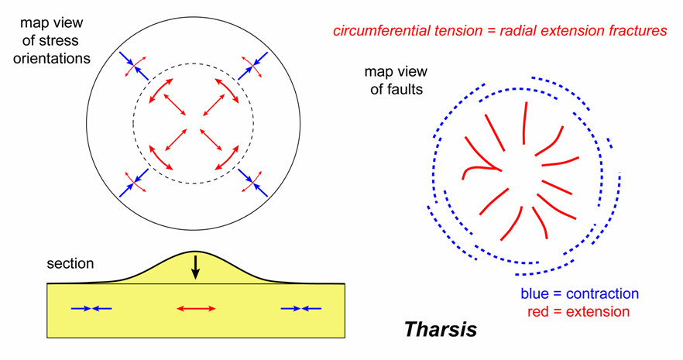
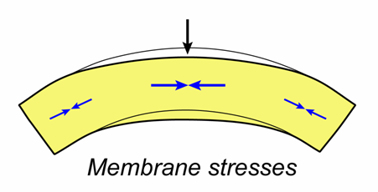
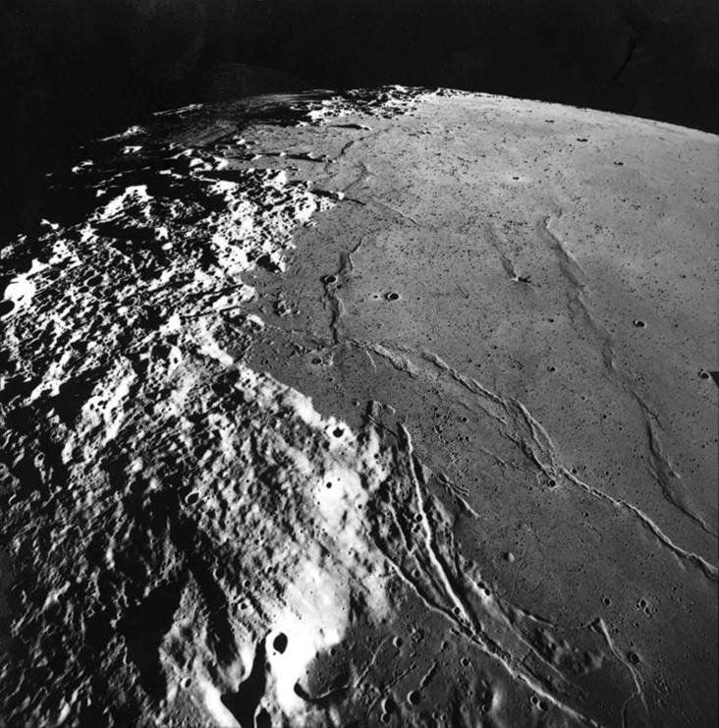
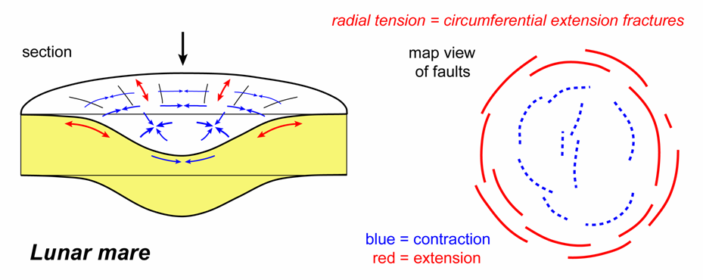
Local extension around loaded lithosphere 2
If the load is wide compared with the planetary radius, then flexural subsidence is counteracted by the resistance to large scale changes in
curvature of the lithospheric shell (membrane stresses)
Mare Serenitatis
This leads to tensile hoop stresses around the load and hence to a set of radial extension faults
Contrast this with the circumferential extension faults that arise around loads that are smaller in diameter where flexural subsidence is possible
Notes:
The nature of membrane stresses can be visualized by trying to deform a table tennis ball. When applying a wide load (squashing the ball with the palm of your hand), the membrane stresses effectively support the load, but when the load is applied over a small area (e.g., by pressing the tip of a pencil into the ball), the load is supported by the flexural stresses. Note that the significance of membrane stresses depends critically on the flexural rigidity of the lithosphere and hence upon factors that control the thickness of the part of the lithosphere that behaves elastically
Thus, the radial fractures around the Tharsis bulge are attributed to the fact that the loading of the lithosphere by the volcanic edifice is over an area that is wide compared with the radius of Mars. Around the perimeter of the bulge there are circumferential wrinkle ridges (on wrinkle ridges, see Class 8 Slide 8) that support this interpretation. For further details of the Tharsis radial fracture story, see Watters & Schultz (editors), 2010, Planetary Tectonics, Cambridge University Press, p.207-212, and for an analysis of the timing of formation of the faults around Tharsis, see Bouley et al., 2018, Earth & Planetary Science Letters 488:126-133, https://doi.org/10.1016/j.epsl.2018.02.019
Figures (by Steve Covey-Crump based on diagrams by Banerdt et al., 1992, In: Kieffer et al. (editors) Mars, University of Arizona Press, p.249-297). The thickness of the arrows is intended to convey the magnitude of the stresses
Image (from http://www.lpi.usra.edu/resources/apollo/frame/?AS17-M-0953): Apollo 17 photograph of the west side of Mare Serenitatis. Note the wrinkle ridges in the interior of the mare and the arcuate rilles on the mare margin

Slide 15
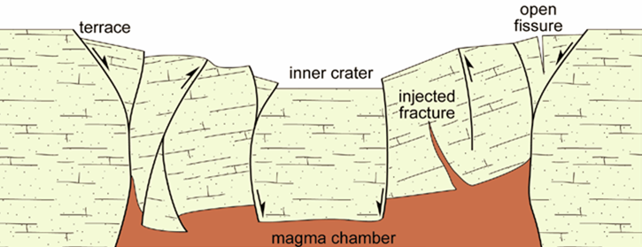
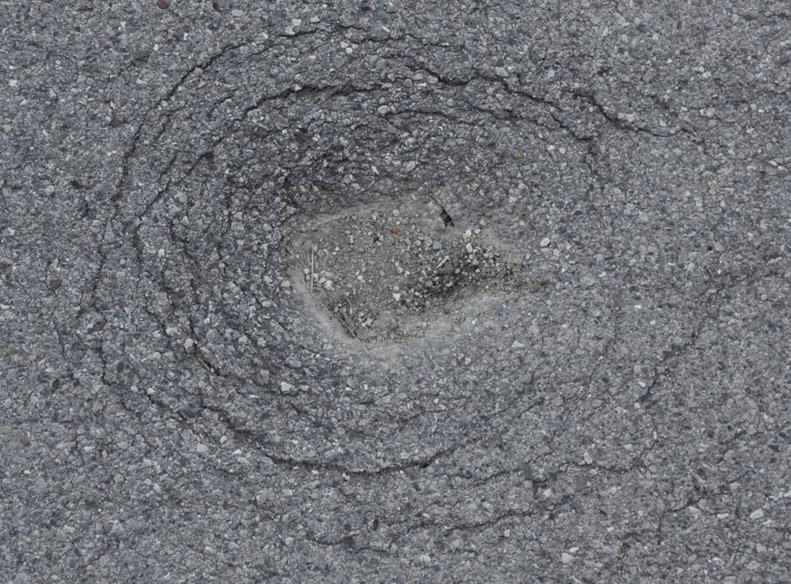
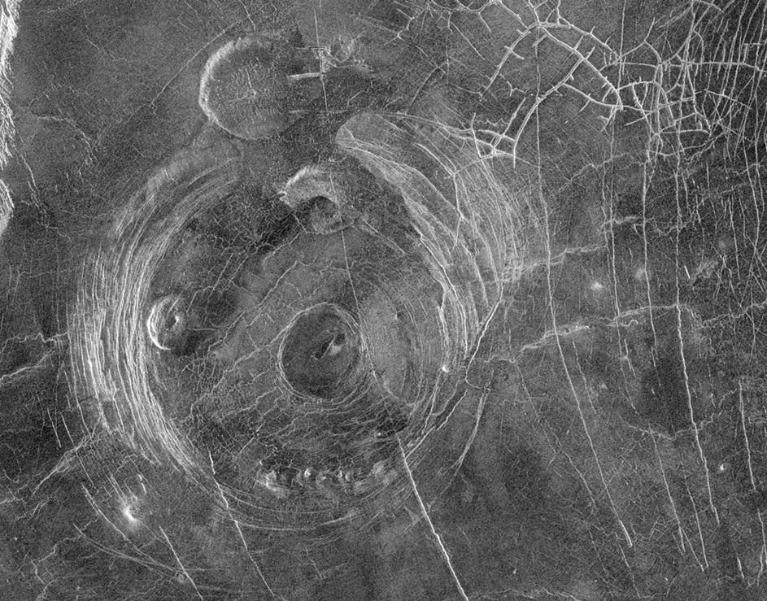
Local extension around areas of subsidence
If a cavity forms at depth (e.g., by emptying a magma chamber during an explosive eruption), the surface units may collapse into it along a set of concentric normal faults (ring faults)
Caldera collapse
Concentric fractures within tarmac
Aine Corona, Venus
Notes:
Figure top right (from J-P Burg’s 2015 lecture notes, www.files.ethz.ch/structuralgeology/JPB/files/English/3extsyst.pdf, p.83): schematic section of faults around a caldera. Modelling with sand suggests that typically most of the collapse occurs on outward-dipping reverse faults in the interior of the caldera, with inward-dipping, curved normal faults forming around the periphery relatively late in the story to accommodate the ongoing subsidence in the interior. However, the precise response depends upon the depth and shape of the magma chamber. The faults around calderas are significant influences on the location and migration of eruptive vents, the degree of subsidence, the style of post-caldera resurgent magmatism, and the extent of hydrothermal circulation
Image bottom right (from photojournal.jpl.nasa.gov/catalog/PIA00202): a Magellan radar image of Aine Corona, Venus. Radial and concentric fracture patterns around volcanic edifices on Venus are classified into novae, coronae, calderas and arachnoids (see Krassilnikov, 2006, Lunar & Planetary Science 37: 1853 – www.lpi.usra.edu/meetings/lpsc2006/pdf/1853.pdf)
Photo bottom left (Steve Covey-Crump): ring fractures around a pit in the road surface, road up to the accommodation at Senez, near Barrême, SE France

Slide 16
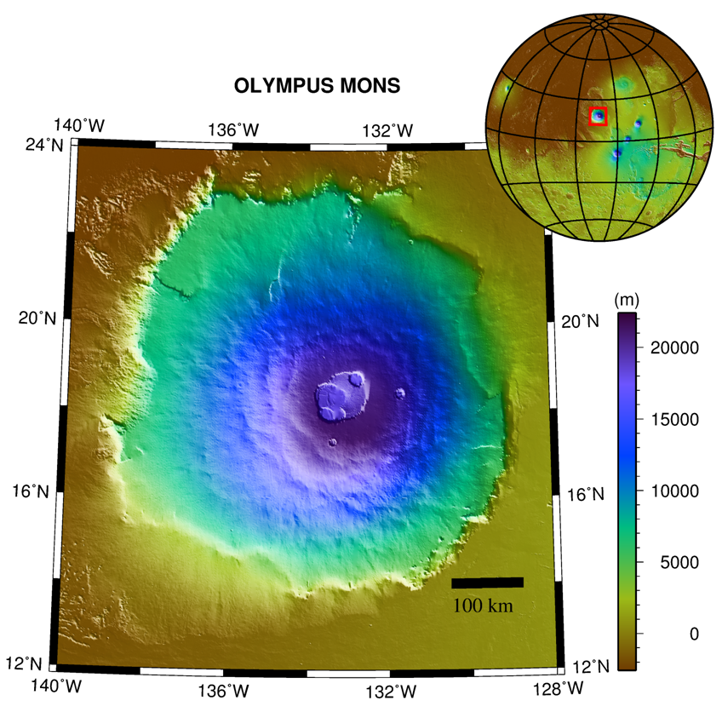
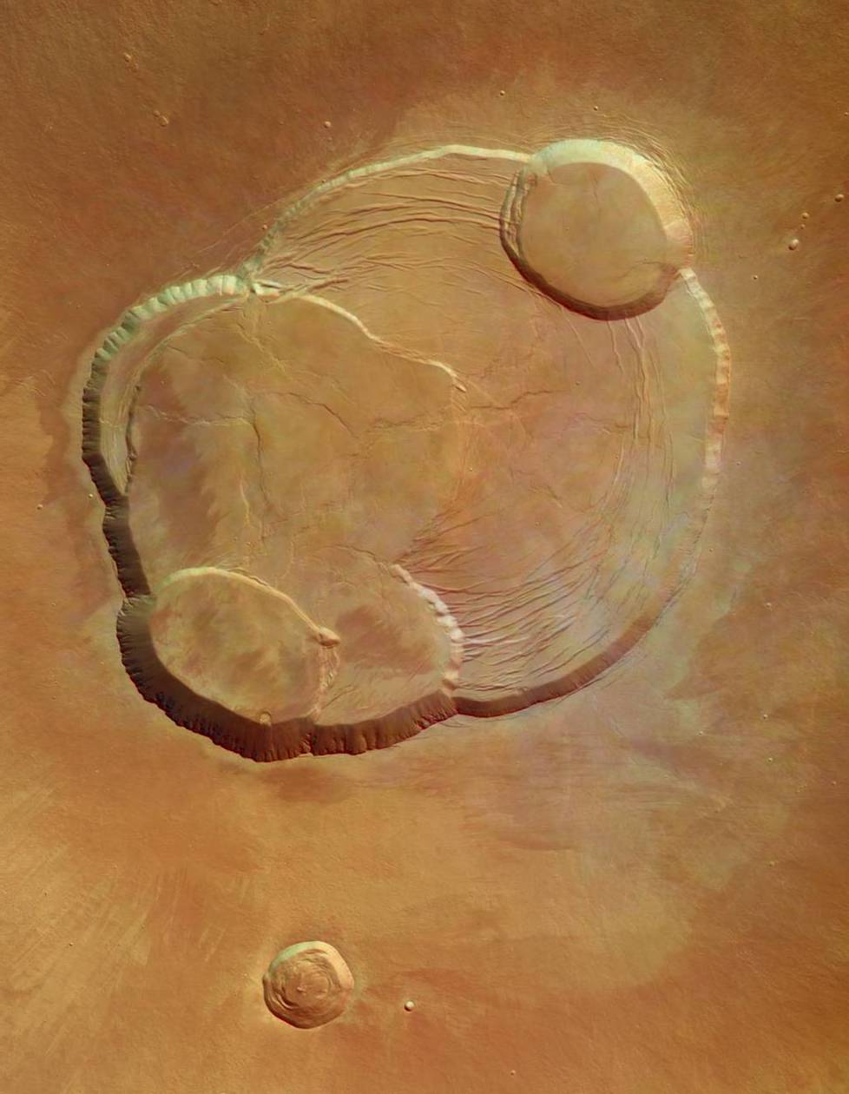
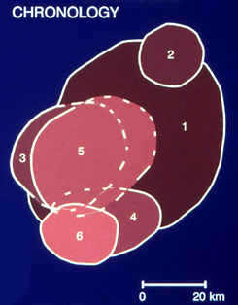
Local extension around areas of subsidence 2
Nested caldera complex, Olympus Mons, Mars
Notes:
Figure top left (http://upload.wikimedia.org/wikipedia/commons/b/b1/Olympus_Mons_Topography.png)
Image right (from http://sci.esa.int/science-e-media/img/4d/Olympus_Mons.jpg): nested caldera complex at the summit of Olympus Mons, Mars Express
Figure bottom left (http://www.lpi.usra.edu/publications/slidesets/hawaiivolcanoes/images/hawaii37.jpg)

Slide 17
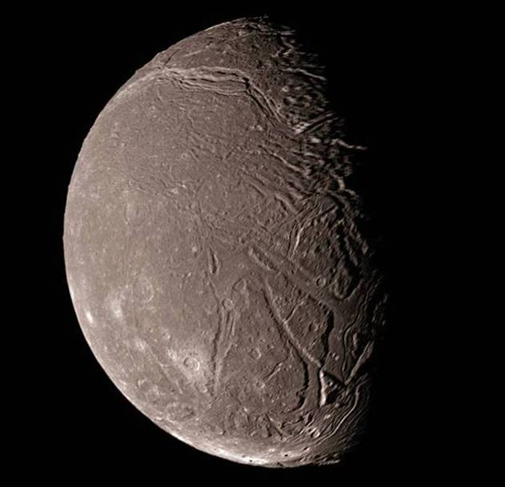
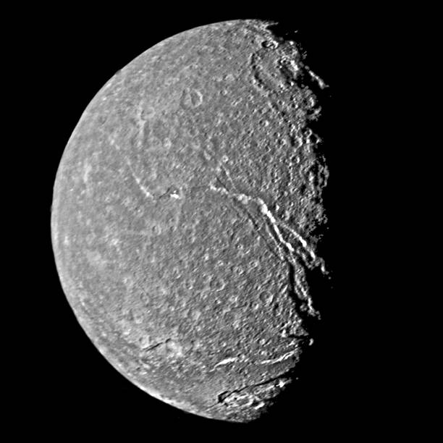
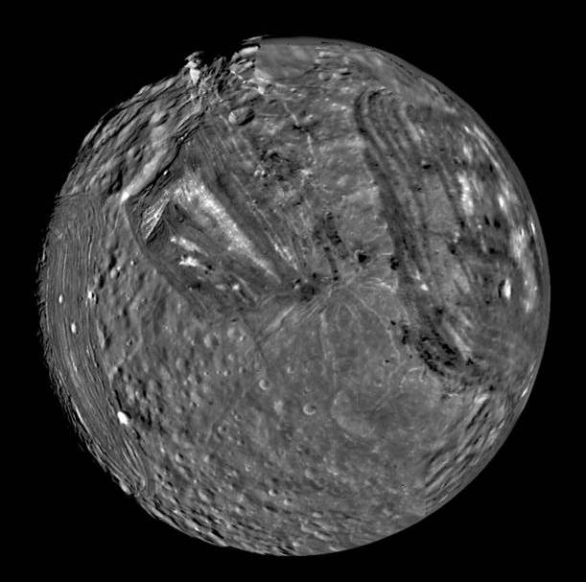
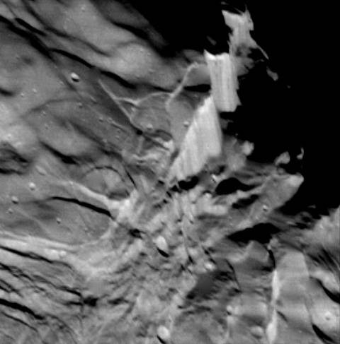
Extension from global expansion
Several of the mid-sized moons of Uranus and Saturn show global distributions of extensional faults
These are attributed to global expansion induced by the freezing of a liquid water / ammonium hydrate interior during planetary cooling
Moons of Uranus: Ariel (top left), Titania (bottom left), and Miranda (below). The detail is of Verona Rupes, a ?slickensided cliff face, 10-20 km high, visible on the rim of Miranda (at top)
Notes:
On the theory of a freezing interior leading to global expansion, see Plescia, 1987, Nature 327: 201-204, https://doi.org/10.1038/327201a0
The images are all from Voyager 2 (1986)
Image top left (from www.solarviews.com/cap/uranus/ariel.htm)
Image bottom left from http://photojournal.jpl.nasa.gov/jpeg/PIA00039.jpg
Image bottom middle from http://photojournal.jpl.nasa.gov/jpeg/PIA01490.jpg
Image bottom right from http://photojournal.jpl.nasa.gov/jpeg/PIA00044.jpg

Slide 18
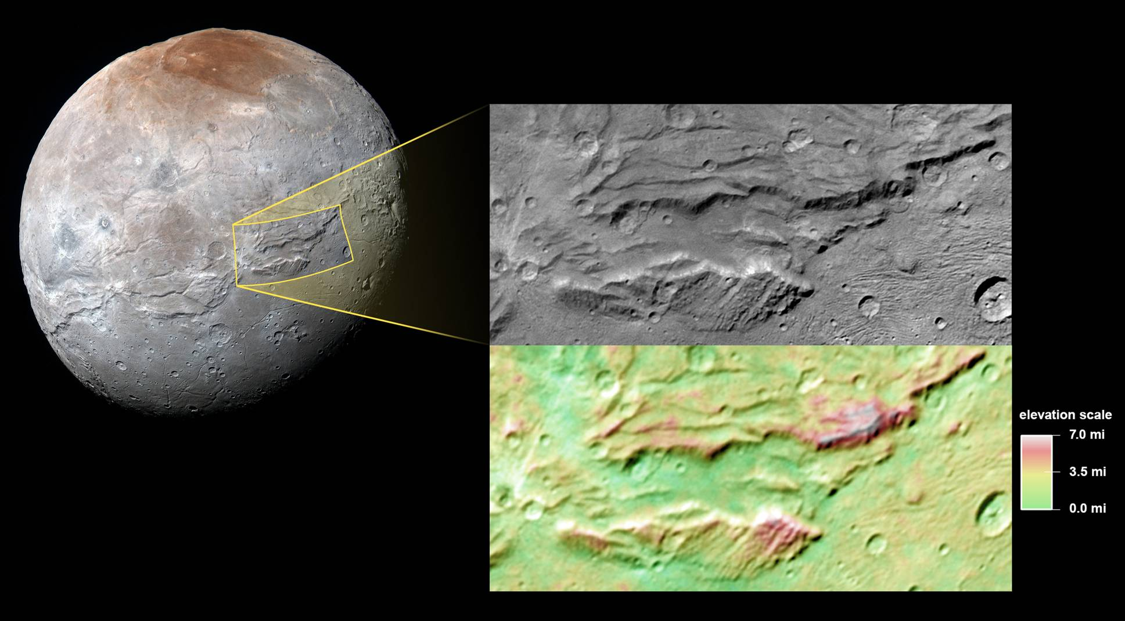
Extension from global expansion 2
Charon: 1800 km long equatorial system of faults and fractures that are up to 7.5 km deep
→ extension of a water ice crust during freezing of a subsurface ocean as the moon cooled
Notes:
For a summary of the geology of Pluto and Charon based on the data from the New Horizons mission during the July 2015 fly-by, see Moore et al., 2016, Science 351: 1284-1293, https://doi.org/10.1126/science.aad7055
Figure (from http://www.nasa.gov/feature/pluto-s-hulk-like-moon-charon-a-possible-ancient-ocean): image of Charon, the largest moon of Pluto, obtained on 14 July 2015 during the New Horizons fly-by. Charon is 1200 km in diameter. The deep canyon is informally known as Serenity Chasma and is considered to be the surface expression of steeply dipping normal faults that continue to depths of tens of kilometres. The extensional fault system represents a global areal extension of ~1% which, from crater densities, is estimated to have occurred early (>4000 Ma) in Charon’s history

Slide 19
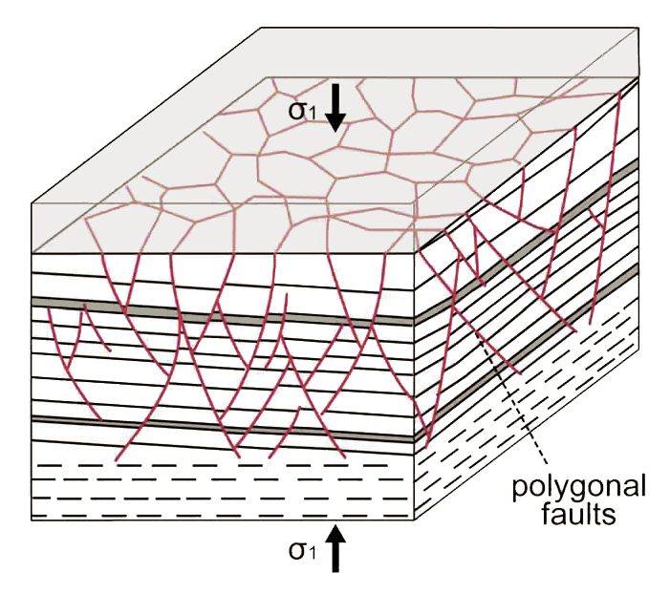
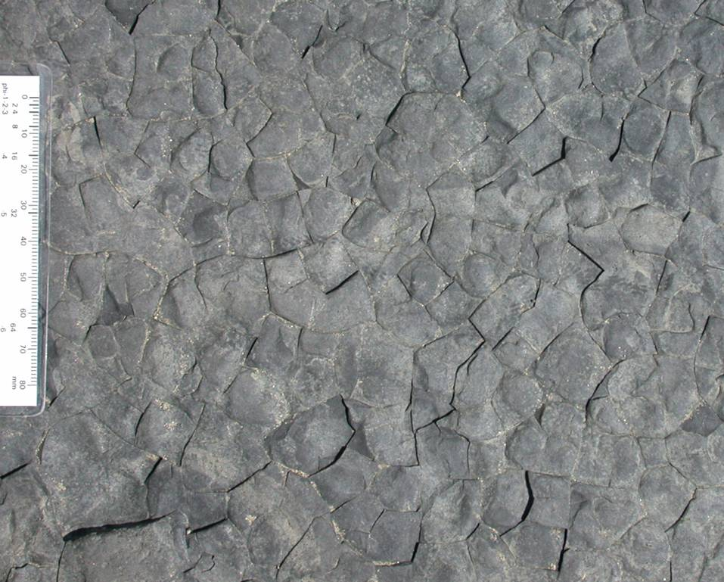
Polygonal normal faults
Layer-bound systems of small dip-slip normal faults (slip < 100 m), arranged in 3D arrays with a polygonal map pattern, are commonly developed over large areas (50000 km² +) within clay-rich lithologies
Polygonal fractures, Amroth
Mode of formation remains controversial
Vertical compaction with some lateral expansion in lithologies that have small coefficients of friction, OR
Chemically driven volume contraction during diagenetic reactions
Notes:
Considerable attention has been given to polygonal fault systems because the faults may have a significant influence on fluid flow in mud-rich lithologies that are important as top-seals in hydrocarbon reservoirs or which are used for waste (CO₂, nuclear) disposal. For a commentary on some of the interesting features and unknowns about polygonal fault systems, see Cartwright, 2014, Geology 42: 559-560, https://doi.org/10.1130/focus062014.1. For more detailed reviews, see Goulty, 2008, Petroleum Geoscience 14: 389-397, https://doi.org/10.1144/1354-079308-781; Cartwright, 2011, Marine and Petroleum Geology 28: 1593-1610, https://doi.org/10.1016/j.marpetgeo.2011.06.004
The vertical compaction explanation of the formation of polygonal faults notes that during vertical compaction of a clastic sediment with zero lateral strain, the ratio between the horizontal effective stress (σ_{H}) and the vertical effective stress (σ_{V}) is approximately given by
K₀ = σ_{H} / σ_{V} = [ν/(1-ν)]
where ν is Poisson’s ratio (this is the uniaxial strain reference state, see Class 5 Slide 29). But for materials with zero cohesive strength, we may also write for frictional sliding on normal faults
σ_{H} / σ_{V} = [(1+µ²)^{½} - µ]²
where µ is the coefficient of friction (the derivation of this relationship comes from the geometry of the Mohr circle diagram shown on Class 7 Slide 22, with σ_{V} = σ₁ and σ_{H} = σ₃ – see Class 7 Slide 23). Slip on the normal faults occurs if
K₀ < [(1+µ²)^{½} - µ]²
For clay-rich lithologies K₀ ~ 0.7 and µ ~ 0.1 and so this inequality is satisfied (0.7 < 0.819) and so slip occurs; in other lithologies K₀ is smaller and µ is larger (typically K₀ ~ 0.4 and µ ~ 0.6) and so the inequality is not satisfied (slip does not occur). For this model, see Goulty & Swarbrick, 2005, Journal of the Geological Society, London 162: 587-590, https://doi.org/10.1144/0016-764905-004. Clay mineral rich lithologies commonly have anomalously small coefficients of friction compared with most lithologies (see Class 7 Slide 25)
The explanation of the formation of polygonal faults that is based on volume contraction focuses on volume contraction by the removal of porosity. Historically, particular attention has been given to syneresis, that is, to fractures opened up when fine particles coagulate when subjected to electrostatic or osmotic forces of attraction. However, interparticle forces of attraction are very weak compared with confining pressures once the sediment has been buried to depths of more than a few tens of metres, and so attention has switched away from syneresis and on to the onset of diagenetic reactions (particularly those involving dissolution) as a way of promoting pore collapse and matrix contraction
The layer bound nature of polygonal fault systems with no comparable deformation features in the overlying and underlying units has been used to argue that they are not tectonic structures. However, syntectonic polygonal normal fault sets have been reported (see Petracchini et al., 2015, Frontiers in Earth Science 3, article 67, https://doi.org/10.3389/feart.2015.00067)
Figure top left (from Petracchini et al., 2015, Frontiers in Earth Science 3, article 67, https://doi.org/10.3389/feart.2015.00067)
Photo bottom right (Steve Covey-Crump): polygonal fractures developed in mudstone units within the Bishopton Mudstone Formation, Telpyn Point, Amroth, Pembrokeshire. Whether these polygonal fractures are a small-scale version of polygonal fault systems or just some weathering curiosity needs to be established

Slide 20
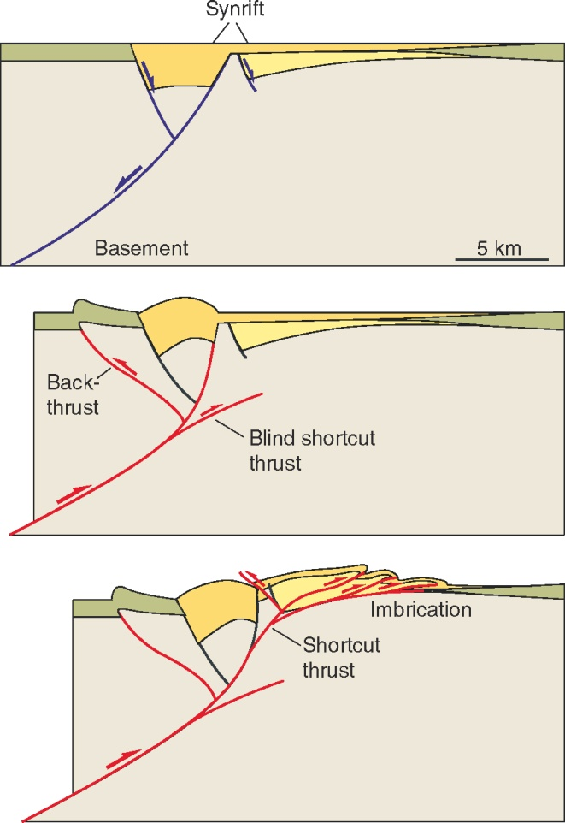
Inversion tectonics
As a further motivation for considering the geometry of extensional fault systems, it is noted that contractional orogenic belts develop in sequences that have had a previous history of rifting and normal faulting on a passive margin. During contraction these normal faults may be reactivated as thrusts, and hence the geometry of extensional fault systems may profoundly influence the geometry of the subsequent thrust systems
The reactivation of pre-existing faults but with the opposite sense of dip-slip displacement is described as inversion
Normal faults tend to be steeper than thrusts, particularly towards the Earth’s surface, and so contraction commonly leads to more gently dipping shortcut faults near the surface
Notes:
For a discussion of the significance of inversion in petroleum exploration, see Cooper & Warren, 2010, Geological Society, London, Special Publications 335: 827-846, https://doi.org/10.1144/SP335.33
Figure from Fossen, p.373

Slide 21
Terminology

Slide 22
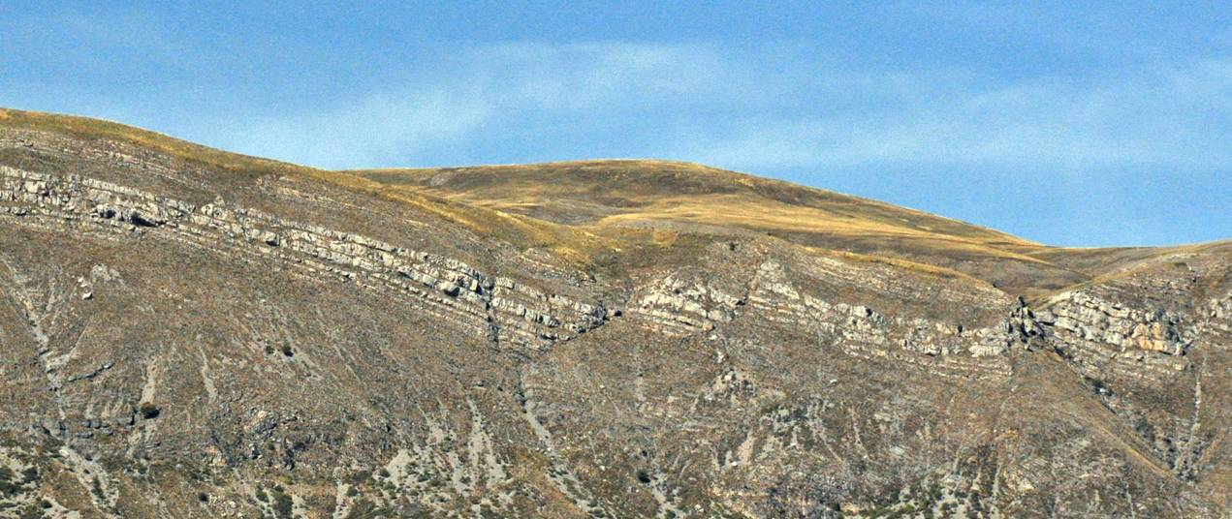
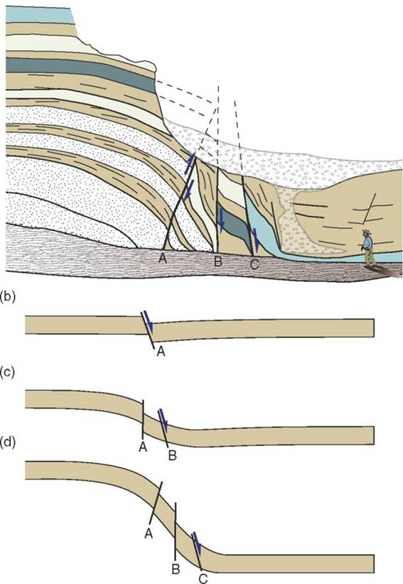
Extensional faults
A fault is described as extensional if it leads to elongation perpendicular to the strike of the fault. Hence faults with a normal component of dip-slip displacement are extensional
View NW from the Panorama du Vélodrome, Digne-les-Bains, France
This definition takes the surface of the Earth (assumed horizontal) as reference. If instead we were to define an extensional fault as one that lengthens a given layer, then in certain scenarios reverse faults can be extensional (see fault A in the bottom diagram of the figure right)
Sketch of rotated normal faults, San Rafael Desert, Utah
Notes:
Note that in a metamorphic core complex, on the back side of the dome the extensional faults are actually reverse faults (see Slide 9 figure right, particularly sections B and C – on the left side of the dome the extensional faults have been rotated so much by the uplift of the dome that they have become reverse faults). Similarly, normal faults can, in certain scenarios, be contractional (see Fig. 17.3 Fossen; faults in the toe of a landslip that dip down slope)
Photo (Steve Covey-Crump) showing a set of extensional faults that have lengthened the faulted layer
Figure from Fossen, p.378

Slide 23
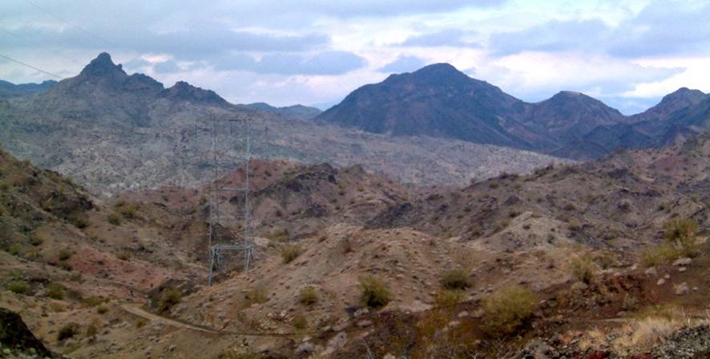
Extensional faults 2
Extensional faults exist with lengths and displacements of millimetres through to those in metamorphic core complexes that are on the scale of mountain ranges with displacements of up to ~ 100 km
Those with large displacements are gently dipping and are described as detachments (an old term for these that is no longer used is a lag fault)
Extensional detachments may be distinguished from thrusts because they bring younger rocks over older ones or rocks of low metamorphic grade over rocks of higher grade
Whipple Mountain detachment, south-eastern California
Notes:
Note that the largest displacement extensional faults have rather less displacement than the largest displacement thrust faults (Class 7 Slide 38; Class 8 Slide 12)
Gently dipping extensional faults with large displacements present a significant mechanical paradox: if the rocks involved in the faulting have normal frictional properties, that is, frictional properties that follow Byerlee’s law (see Class 7 Slide 25), then since σ₁ is vertical in an extensional setting, they should dip at ~60° (see Class 7 Slides 22-24) – faults with dips of less than 30° are very poorly oriented if the kinds of brittle failure analysis techniques that we used in Practical 6 are to be believed. Gently-dipping extensional faults are commonly explained as being due to the presence of minerals with low coefficients of friction (e.g., phyllosilicates) but this is not a very satisfactory explanation for the general case, and the matter remains something of an open question (for a survey of these issues, see Colletini, 2011, Tectonophysics 510: 253-268, https://doi.org/10.1016/j.tecto.2011.07.015). For a more imaginative solution that has been applied to the Whipple Mountain detachment, see Axen, 2020, Geological Society of America Bulletin 132: 1817-1828, https://doi.org/10.1130/B35386.1
A jump in metamorphic grade across a fault can be used to establish whether the fault is extensional or not (see Wheeler & Butler, 1994, Journal of Structural Geology 16: 1023-1027, https://doi.org/10.1016/0191-8141(94)90083-3), and this is particularly useful in analysing the sense of movement of exhumed lower and mid-crustal faults – note that there should be a sharp change from high grade in the footwall to lower grade in the hanging wall if the fault is a large displacement extensional fault
Photo (from instruct.uwo.ca/earth-sci/fieldlog/cargo/phot/wippleklippe3.jpg) showing the Whipple Mountain detachment – the fault is the obvious contact between the dark-coloured Tertiary units above and lighter coloured mylonitic gneisses beneath. The total slip on the fault system is estimated to be 40-50 km although the currently exposed fault seen here may have had less. Whipple Mountain is an example of a metamorphic core complex

Slide 24
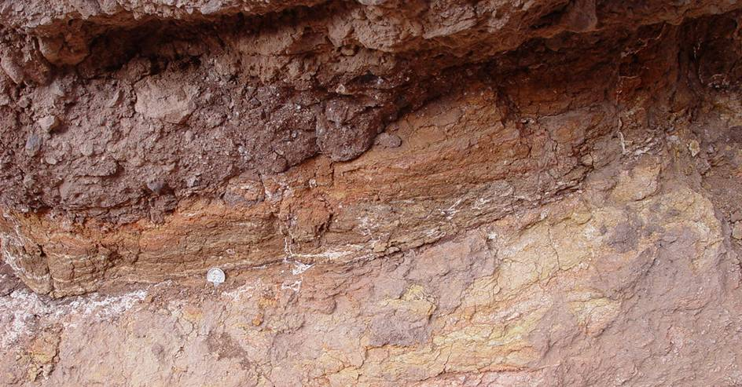
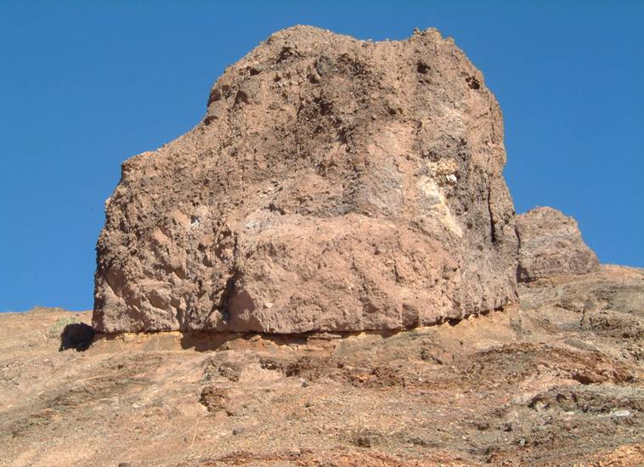
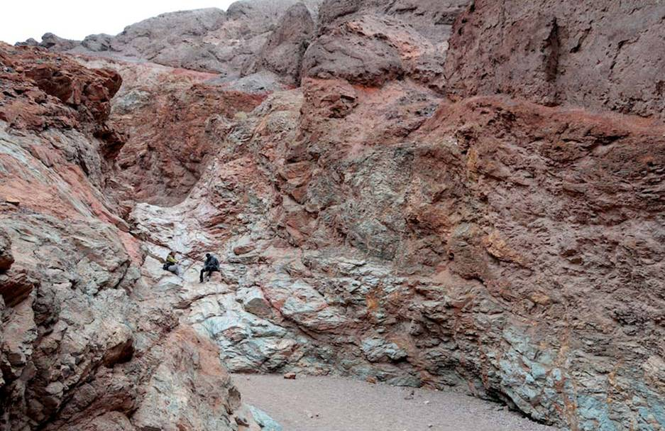
The fault zone
The fault zone at shallow levels on a low angle detachment is commonly a thick region of distributed cataclasis. This reflects the late stages of movement under transtensional conditions, often in the presence of a large pore fluid pressure
Badwater turtle-back, Death Valley
Notes:
An example of the sort of stress state analyses that can be done using brittle structures in detachment fault zones is given by Axen & Selverstone, 1994, Geology 22: 835-838, https://doi.org/10.1130/0091-7613(1994)022<0835:SSAFPL>2.3.CO;2
Photo top right (from geotripperimages.com/Tectonic_Processes/Faults.htm): fault gouge on the Badwater turtleback fault near Natural Bridge, Death Valley, California
Photo left (from instruct.uwo.ca/earth-sci/fieldlog/cargo/phot/2006/060302_35b_badcongbrec.JPG): klippe of brecciated fanglomerates in the hanging wall of the Badwater turtleback
Photo bottom right from Fossen (one of the extra figures on the web-site for the book, folk.uib.no/nglhe/StructuralGeoBook.html): Badwater turtle-back fault bringing Quaternary conglomerates over metamorphic rocks. Notice the brecciation of the footwall metamorphics

Slide 25
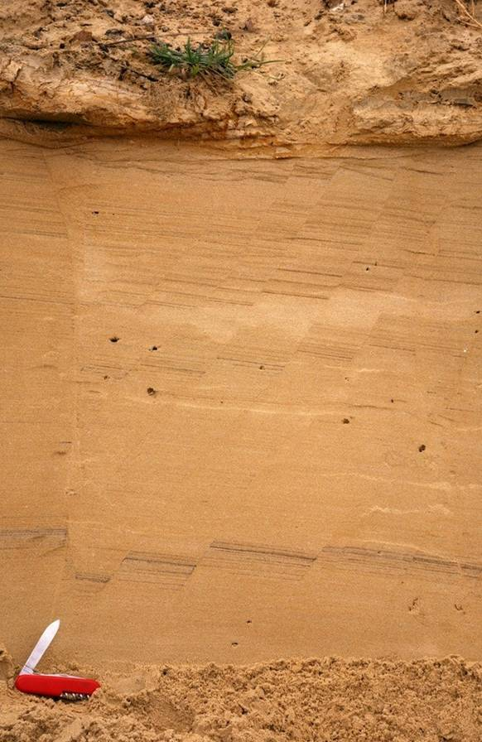
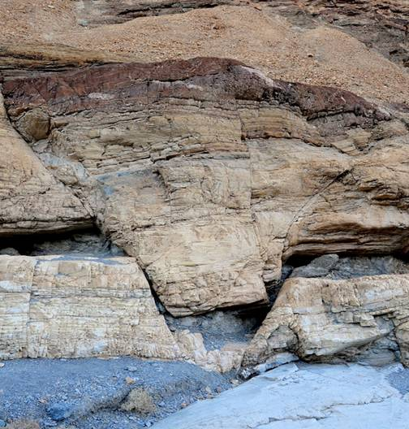

Shape of the fault surface: planar/listric/antilistric
Extensional fault surfaces may be
planar (far left),
listric (below) or,
antilistric (left – fault on the right)
Notes:
Photo left (from the BGS image database: geoscenic.bgs.ac.uk/asset-bank/action/viewHome, image P007899): planar faults in the Corton Sands (Quaternary), Corton, Suffolk
Photo bottom right (from the BGS image database: geoscenic.bgs.ac.uk/asset-bank/action/viewHome, image P211208): listric (concave-upward) faults in a succession of lignites and clays (Southacre Member of the Bovey Formation – late Eocene/Oligocene age), East Golds Clay Pit, Newton Abbot, Devon
Photo top right (from Fossen, p.376): antilistric (convex-upwards) fault, Mosaic Canyon, Death Valley

Slide 26


Shape of the fault surface: ramps/flats
Large displacement extensional faults commonly have a ramp-flat-ramp geometry
In experiments it has been shown that such geometries arise when two steep fault segments link up along a weak horizon
The orientation of the ramp with respect to the transport direction gives rise to the same frontal/oblique/lateral terms that are used to describe ramps in thrust systems
Notes:
The role of stratigraphic variations in strength on the development of normal faults is reviewed by Ferrill, 2017, Journal of Structural Geology 94: 275-302, https://doi.org/10.1016/j.jsg.2016.11.010
Figure bottom left from J-P Burg’s 2015 lecture notes (www.files.ethz.ch/structuralgeology/JPB/files/English/3extsyst.pdf), p.67
Figure right from Fossen, p.386

Slide 27


Fault systems: imbrication and duplexes
Sets of listric extensional faults that merge down into a detachment form extensional imbricate fans; if they also merge upwards into an extensional roof fault, they form an extensional duplex
The term horse applies for the fault bound blocks within a duplex; the term rider is used for the fault blocks in an imbricate fan
Notes:
Figure from Fossen, p.387
Photo (Steve Covey-Crump): an extensional detachment in a metamorphic core complex, Basin-and-Range Province, western USA. Rotation of the faults (on a much larger scale than this picture) associated with doming as the core complex was formed has changed the extensional detachment into a low-angle reverse fault. Two listric normal faults that merge down into the detachment are highlighted but there are other faults within the detachment hanging wall – note particularly the planar normal faults in the hanging wall of the left fault

Slide 28


Fault systems: antithetic/synthetic faults
Commonly, in extensional fault systems significant displacement occurs on smaller scale faults within the hanging wall of the main fault
If the smaller faults are ~ parallel to the main fault and have the same sense of shear, they are synthetic faults; if they are in the conjugate orientation, they are antithetic faults
Section across a listric fault system from the Gulf of Mexico together with the seismic data used to construct it
Notes:
Recall that a conjugate fault is one with approximately the same angle of dip as the main fault, but which is dipping in the opposite direction
Figures from McClay, 1995, Petroleum Geoscience 1: 163-178, https://doi.org/10.1144/petgeo.1.2.163. The faults dipping to the SE are synthetic faults; the faults dipping to the NW are antithetic faults

Slide 29


Fault systems: horsts/grabens
A graben is a downthrown block bounded on each side by conjugate normal faults that each dip towards the downthrown block
A horst is a relatively uplifted block bounded by two conjugate normal faults that each dip away from the uplifted block
A half-graben is a downthrown and tilted block bounded on only one side by a major normal fault
Notes:
Photo (from Fossen, one of the extra figures on the web-site for the 2nd edition of the book, https://structuralgeo.wordpress.com/): graben near Zanjan, Iran
Figure from Twiss & Moores, p.94

Slide 30



Horsts/grabens 2
Rima Ariadaeus, Moon
Crater cut by normal faults on Mars – the normal dip-slip sense of offset is apparent from the displacement of the crater walls
Tantalus Fossae, on the eastern flank of Alba Mons, Mars
Notes:
Image top left (from history.nasa.gov/ap10fj/as10-image-library.htm): Apollo 10 image (photo AS10-31-4646) of Rima Ariadaeus
Image bottom middle (from www.flickr.com/photos/lunarandplanetaryinstitute/4885341169/sizes/o/in/set-72157624710708504): Mars Reconnaissance Orbiter (HiRISE) image of a crater cut by faults. Note that the offset of the crater walls indicates that fault movement occurred after the crater forming event – perhaps immediately after given that there seems to have been no fault displacement after the surface inside the crater was formed
Image right (from en.wikipedia.org/wiki/File:Simple_Graben_Tantalus.jpg): the horst and graben features of Tantalus Fossae probably resulted from the flexural response of the Martian lithosphere to the weight of the Tharsis bulge (they are radial to that bulge; see Slides 13-14)

Slide 31


Half-grabens: tilting
In half-grabens the downthrown block is back-tilted – the angle of tilt depends upon the dip of the fault surface and how the displacement is accommodated within the hanging wall
Notes:
Photo top (Steve Covey-Crump): back-rotation of the former road surface at the Mam Tor landslip. The increase in tilt towards the right in this photo suggests that the underlying slip surface is listric (decreasing in dip to the right)
Photo bottom (Steve Covey-Crump): tilting of the units in the Basin-and-Range Province of the western USA is the result of slip on underlying extensional faults. In this photo the beds dip to the left implying that the underlying fault dips to the right

Slide 32
Modes of extension and associated structures

Slide 33



Planar non-rotational faults
The classical normal fault is planar and involves translation without rotation during slip; such faults control symmetrical grabens (e.g., Rhine Graben)
Following Anderson, with the maximum compressive stress (σ₁ ) vertical and a coefficient of internal friction of ~0.6, such faults should dip at ~60°
extension
e = δ L/(L₁ + L₂)
(pure shear)
How do conjugate faults work – are they simultaneously active?
What happens to such faults at depth?
How is it possible to have more than ~30% extension?
Notes:
On Anderson’s classification of faults, see Class 7 Slides 23-24. The questions posed on this slide were among the most important of those addressed during the revolution in understanding of extensional fault systems that occurred in the mid-1980s
Photo (from the BGS image database: geoscenic.bgs.ac.uk/asset-bank/action/viewHome, image P212486): a horst picked out by lines of flints in Chalk, Shoreham Cement Works Quarry, Shoreham-by-Sea, Sussex
Figure left from Fossen, p.381
Figure bottom right from J-P Burg’s 2015 lecture notes (www.files.ethz.ch/structuralgeology/JPB/files/English/3extsyst.pdf), p.73

Slide 34



Planar rotational faults (domino mode)
Sections across extended parts of the upper crust commonly show a series of rotated fault blocks bounded by planar faults, and arranged like a set of tilted dominoes
Incipient faults form at 60° (blue), slip leads to 30° rotation; a new set of faults form at 60° (red)
extension: e = δ L / L = (d cos θ + L cos α - L ) / L
= [ sin (α +θ ) / sin θ ] - 1
Notes:
Photo top right (by José Miguel Martínez-Martínez, www.ugr.es/~jmmm/Fotos_Eng.htm): domino faulting in the Sierra Nevada Betics (southern Spain)
Note that the extension formula involves a number of approximations: (1) no strain within the blocks, (2) faults and layers rotate simultaneously and at the same rate, (3) all faults have the same dip and same offset. A derivation of the extension formula shown on this slide is given by Twiss & Moores, p.112
Figure bottom left from Fossen, p.380
Figure bottom right from J-P Burg’s 2015 lecture notes (www.files.ethz.ch/structuralgeology/JPB/files/English/3extsyst.pdf), p.73

Slide 35

Planar rotational faults 2
The rotating domino picture means that voids open up during deformation
At the end of the system these may be avoided by having a listric fault
The voids between the base of the blocks and the substrate may be removed if there is a mobile underlying medium (over-pressured mudstones, evaporites, magma) and/or if there is some internal deformation of the blocks (brecciation, ductile flow)
This style of extension can accommodate large strains
The generation of successive sets of faults can lead to some complex fault and layer cross-cutting relationships
Dominoes at thin-section scale: brittle failure of feldspar porphyroclasts in mylonites from the Betics (southern Spain). Note the ductile deformation of the substrate
Notes:
To satisfy the space problem at the ends of the domino system, listric faults are needed at both ends and these must dip towards each other so that on one side of the system the dominoes dip one way and on the other, the other; in the middle a graben is needed to connect the two sets (see figure on Slide 53, top section)
Photo (by José Miguel Martínez-Martínez, www.ugr.es/~jmmm/Fotos_Eng.htm): mylonite with ultramylonite bands, Betics, southern Spain

Slide 36

Listric rotational faults
Extension on listric faults must be accompanied by significant hanging wall deformation in order to resolve the space problems
Rigid displacement of the hanging wall of a listric fault opens a large gap
If the bottom edge of the hanging wall is forced to conform to the shape of the fault (by vertical subsidence or other deformation processes), while keeping layer length constant, the resulting geometry is a rollover antiform. But this generates another space problem at the end of the section
This second space problem may be alleviated by allowing layer-parallel extension through the formation of a set of antithetic faults
Notes:
The movie (from Rick Allmendinger’s website, http://www.geo.cornell.edu/geology/faculty/RWA/movies/ OR https://www.rickallmendinger.net/), ListricNormalFault.m4v, that accompanies this lecture shows the development of a rollover antiform
Figure from Twiss & Moores, p.108

Slide 37

Listric rotational faults 2
In fact, the space problems created by slip on a listric fault may be resolved by a combination of rollover antiform and synthetic/antithetic fault forming processes
The general process of hanging wall deformation and subsidence in extensional systems is described as hanging wall collapse
Notes:
Figure (from J-P Burg’s 2015 lecture notes (www.files.ethz.ch/structuralgeology/JPB/files/English/3extsyst.pdf), p.75) showing some different ways in which hanging wall collapse may be achieved

Slide 38

Listric rotational faults 3
Hanging wall collapse through the formation of a rollover antiform in combination with a set of synthetic normal faults
Notes:
Photo (from Fossen, one of the extra figures on the web-site for the book, folk.uib.no/nglhe/StructuralGeoBook.html; see also Fossen, p.197): hanging wall collapse, Matulla Formation, Wadi Matulla, Sinai

Slide 39


Listric rotational faults 4
Analogue (sandbox) models of extension on a listric fault reproduce these features
Notes:
Figures from McClay, 1995, Petroleum Geoscience 1: 163-178, https://doi.org/10.1144/petgeo.1.2.163. This paper describes the results of sand box models of extension under a variety of scenarios
The movie, Listric-small.mov that accompanies this lecture (but you’ll need QuickTime to view it) shows the results of a sand-box model of slip on a listric normal fault with accompanying hanging wall collapse

Slide 40

Deformation above a ramp-flat geometry fault
Hanging wall deformation is more complex on faults that have abrupt changes in dip
In a flat-ramp-flat situation the hanging wall is forced to deform into a ramp synform
In a ramp-flat-ramp situation slip produces a fault-bend antiform in the hanging wall
Mapping the orientation of the axial traces of such folds reveals the footwall ramp geometry (frontal, oblique, lateral) since these traces must run parallel to the associated ramp
Note that the formation of antithetic and synthetic faults may help to accommodate the layer bending
Notes:
Figure from Twiss & Moores, p.95

Slide 41


Deformation above a ramp-flat geometry fault 2
Analogue (sandbox) models also reproduce these features
Note the appearance of reverse faults to help accommodate the folding
Notes:
Figures from McClay, 1995, Petroleum Geoscience 1: 163-178, https://doi.org/10.1144/petgeo.1.2.163

Slide 42


Deformation above a ramp-flat geometry fault 3
. . . and these features are well documented in natural examples
Notes:
Figures from McClay, 1995, Petroleum Geoscience 1: 163-178, https://doi.org/10.1144/petgeo.1.2.163

Slide 43



A note of caution: reverse drag
In a rollover antiform, the bending of the layering is in the opposite sense to drag folding. From this it is concluded that when one sees a rollover antiform, the underlying fault must be listric
However, reverse drag can be produced on a planar fault that dies out simply because the displacement decreases towards the tip of the fault
Normal drag (above)
Reverse drag (left)
Notes:
On reverse drag see (1) Grasemann et al., 2005, Journal of Structural Geology 27: 999-1010, https://doi.org/10.1016/j.jsg.2005.04.006, and (2) Resor & Pollard, 2012, Journal of Structural Geology 41: 98-109, https://doi.org/10.1016/j.jsg.2011.10.012. Note that reverse drag, although geometrically similar, should not be confused with rift-flank uplift in which the footwall adjacent to a fault is uplifted due to a combination of flexural unloading and isostatic readjustment after slip has occurred (e.g., see Egan, 1992, Tectonophysics 202: 291-308, https://doi.org/10.1016/0040-1951(92)90115-M) – for an illustration of this rift-flank uplift, see figure on Slide 47 (area labelled as “back-tilting”)
Photo top right (from Fossen, one of the extra figures on the web-site for the book, folk.uib.no/nglhe/StructuralGeoBook.html): Gulf of Corinth
Photo bottom left (Steve Covey-Crump): shore section at Onich, north-west Scotland. Note that the reverse drag is particularly prominent in the footwalls. Modelling suggests that roll-over antiforms produced on a listric fault may be recognized as such by the relatively small footwall uplift on the fault, whereas folds that look like rollover antiforms but have been produced on planar faults by reverse drag have relatively large footwall uplift
Figure from Resor & Pollard, 2012, Journal of Structural Geology 41: 98-109, https://doi.org/10.1016/j.jsg.2011.10.012

Slide 44
Sequences of fault development

Slide 45

Footwall collapse
Unloading as extension proceeds, results in the extensional system successively cutting back into the footwall
Where a ramp and flat exists, this may result in the formation of an extensional duplex in which at any time the floor fault is the active one while the roof fault is never active as a single fault
As this develops antithetic faults form in conjugate orientations to accommodate deformation in the hanging wall
The resulting geometry is complex and is further complicated by out-of-sequence faulting and/or by increased faulting in the hanging wall perhaps in response to changing deformation conditions
Schematic development of an extensional fault system by progressive footwall collapse
Notes:
Some of these complexities are described by Gibbs, 1984, Journal of the Geological Society, London 141: 609-620, https://doi.org/10.1144/gsjgs.141.4.0609
Figure (from Twiss & Moores, p.109) showing the order of formation (indicated by the numbers) of faults within an extensional fault system

Slide 46

Analogue modelling
Analogue models confirm the complexity of this sequential development story
Note the development of hanging wall collapse in the hanging wall of Fault 6 (stages d-f ) but also footwall collapse during the initiation of faults 2 (stage b) and 6 (stage d)
Notes:
These figures (from Fossen, p.387) are based on plaster experiments by Fossen & Gabrielsen, 1996, Journal of Structural Geology 18: 673-687, https://doi.org/10.1016/S0191-8141(96)80032-0

Slide 47


Syn-tectonic sedimentation
Unravelling the sequence of events in natural extensional systems is most reliably tackled by establishing patterns of subsidence from syntectonic sediments
Particularly useful are the sedimentary infills in half-grabens – if deposited while movement on the fault was ongoing (growth fault) these infills thicken towards the fault
Notes:
Figure top from Burbank & Anderson, 2012, Tectonic Geomorphology (2nd edition), Wiley-Blackwell, p.99
Photo bottom (Steve Covey-Crump): road surface stratigraphy, Mam Tor landslip, 13 April 2012. Successive road repairs at Mam Tor have infilled a half-graben that was generated by landslipping and have thereby formed wedge-shaped “stratigraphic” units
The geometry of the wedge-shaped units within half-grabens may be used to reconstruct the shape of the underlying fault (using the so-called ‘Chevron techniques’, see Slides 57-58)

Slide 48




Fault growth vs. extinction
A synthesis of the sedimentary record in the North Sea Viking Graben during the late Jurassic phase of extension identified three stages in the development of that extensional fault system
Distributed faulting with faults dipping in both conjugate orientations and slow overall extension
Formation of half-grabens as the outward dipping faults die and the inward dipping faults extend, link, and increase their rate of slip (inner faults by more)
Stage 2 at Mam Tor
Notes:
The work in the Viking Graben is described by Cowie et al., 2005, Earth and Planetary Science Letters 234: 401-419, https://doi.org/10.1016/j.epsl.2005.01.039
Figures bottom from Cowie et al., 2005, Earth and Planetary Science Letters 234: 401-419, https://doi.org/10.1016/j.epsl.2005.01.039
Photo top right (Steve Covey-Crump): road surface on the Mam Tor landslip, 13 April 2012
The growth of extensional faults has significant consequences for the tectono-stratigraphic evolution of sedimentary basins. Two end-member models of extensional fault growth are widely cited:
(a) Propagating Fault (or Isolated Fault) Model: extensional faults lengthen as displacement increases so that the linear relationship between log fault length and log max displacement (see Class 7, Slide 38) is maintained throughout their lifespan
(b) Constant Fault Length Model: fault length is established very early and then remains approximately constant as displacement accrues, so that by the end of the fault’s lifespan it is at the place observed on the log fault length and log max displacement curve
Opinion seems to be crystallizing on a hybrid model where during the initial stages of displacement (first 20-30% of the fault’s lifespan) the fault lengthens rapidly, and then “stabilizes” so that there is little lengthening during further displacement (remaining 70-80% of the fault’s lifespan). For a commentary on these matters, with access into the previous literature, see Rotevatn et al., 2019, Journal of Structural Geology 125: 174-184, https://doi.org/10.1016/j.jsg.2018.08.005

Slide 49


Fault growth vs. extinction 2
Localization of almost all the slip on to one through-going fault with the other faults becoming inactive
Stage 3 at Mam Tor; note also the increased tilting of the fault blocks towards the right
Note that in this example, strain migrates inwards across the hanging wall rather than outwards by footwall collapse
Notes:
Figure top right from Cowie et al., 2005, Earth and Planetary Science Letters 234: 401-419, https://doi.org/10.1016/j.epsl.2005.01.039
Photo bottom left (Steve Covey-Crump): section through the repeatedly repaired road stratigraphy, Mam Tor landslip, 13 April 2012

Slide 50

Along strike development
In referring to hanging wall and footwall collapse we have focused on fault system development in a direction parallel to the overall displacement vector, but it is important also to consider the along strike development
Faults die out along strike and where they do so the regional extension is taken up by adjacent faults
Between these faults there is commonly a transfer zone in which deformation is accommodated by folding and faulting, and in some cases, these may be strike-slip transfer faults
Notes:
We will consider the structures associated with strike-slip faults next time (Class 10)
Figure from Twiss & Moores, p.100

Slide 51


Along strike development 2
In rifts extension may be taken up by slip on a master fault on one of the flanks. Along strike the location of the master fault may flip from one side of the rift to the other so that the rift becomes a set of oppositely dipping half-grabens → variety of transfer zone structures
Notes:
Note that if the syn- and post-rift sediments are organic-rich, transfer zone structures are important for establishing the lateral extent of petroleum source rocks and for assessing fluid transport pathways. Consequently, they have received considerable attention, e.g., Gawthorpe & Hurst, 1993, Journal of the Geological Society, London 150: 1137-1152, https://doi.org/10.1144/gsjgs.150.6.1137. For a review of the evolution of such transfer zone structures in extensional fault systems, from their formation through to breaching, and with a consideration of the implications for fluid flow, see Fossen & Rotevatn, 2016, Earth-Science Reviews 154: 14-28, https://doi.org/10.1016/j.earscirev.2015.11.014
Figure left from Burbank & Anderson, 2012, Tectonic Geomorphology (2nd edition), Wiley-Blackwell, p.99
Figure right from Gawthorpe & Hurst, 1993, Journal of the Geological Society, London 150: 1137-1152, https://doi.org/10.1144/gsjgs.150.6.1137

Slide 52
Models of extension

Slide 53

Pure shear vs. simple shear
There are two end-member models of extension at the lithospheric scale
Pure shear: the overall deformation across the region of extension creates symmetric thinning of the lithosphere, accommodated by brittle faulting in the upper crust and plastic deformation at greater depth
Simple shear: extension is localized on to a dipping shear zone that transects the lithosphere
In the pure shear model, the highest geothermal gradient is under the centre of the region of extension; in the simple shear model it is offset to one side. This has important consequences for uplift and subsidence patterns and hence for basin development
Notes:
There is a variant of the simple shear model in which the shear zone becomes horizontal at some depth below the brittle upper crust, with the units under it deforming overall by pure shear
Figure from Fossen, p.389

Slide 54
Section balancing
(extensional regimes)
Some additional notes
Notes:
The following slides describe techniques widely used for constructing cross-sections across extensional fault systems. I used to have a practical developing these techniques but not this year, and so this won’t be assessed in this course unit

Slide 55

Balancing sections to eliminate space problems
In constructing cross-sections through extensional terrains, it is very easy to generate ones that are unrestorable
In the section on the right there is no way that the motion on the two faults can be reversed to produce an originally continuous layer without leaving large gaps or having large overlaps
Note that such failings can be difficult to recognize in cross-sections that contain multiple intersecting faults
Hence, section balancing techniques are just as important for extensional terrains as they are in fold and thrust belts
Notes:
Figure from Twiss & Moores, p.107

Slide 56


Rigid block restoration
If the deformation is entirely by the slip of rigid blocks, then section balancing can be done by using the same line-length balancing techniques used for fold and thrust belts:
Set up template and establish pin-line
Measure the lengths of marker horizons in each fault block, working back in time (important if there are cross-cutting faults), and add them to the template. If the positions of the faults are noted, then their initial dip is recovered
A convenient strategy is to draw the template on a tracing overlay
A successfully restored section
Notes:
Note that the tracing overlay approach serves to demonstrate that this method balances area as well as line-length
Note that rigid block restorations of this kind can be done in map view too (see Fossen, Fig. 21.12)
Figure top from Groshong, 2006, 3-D Structural Geology: A Practical Guide to Quantitative Surface and Subsurface Map Interpretation (2nd edition), Springer, p.328
Figure bottom redrawn by Steve Covey-Crump from Groshong, 2006, 3-D Structural Geology: A Practical Guide to Quantitative Surface and Subsurface Map Interpretation (2nd edition), Springer, p.366

Slide 57

Explicit area balancing
If the hanging wall is not a rigid block, area balancing techniques are required
Note that the same assumptions as outlined when balancing sections in thrust systems apply, namely plane strain and no volume change, and so the section ought to be drawn parallel to the overall fault movement direction
Under these assumptions the two areas ( A and A_{x} ) identified above are equal and so if we know the horizontal displacement ( Δ L ) we can calculate the depth to the detachment ( D ) or vice versa
Notes:
The biggest difficulty with the no volume change assumption is that it ignores compaction (vertical shortening) of the sediments during burial. Hence, ideally compaction should be removed before restoration, e.g., by using some lithology-specific compaction vs. depth curve (see comments in Fossen, p.446-447)
Sections can be drawn oblique to the overall extension direction but corrections must then be applied to account for this obliquity
Figure by Steve Covey-Crump

Slide 58

Area balancing: variants of the Chevron technique
Different ways have been developed to apply the geometry outlined on the previous slide to calculate
  the shape of a listric fault at depth from the known shape of a rollover antiform, or
  the shape of a rollover antiform from the known shape of a listric fault
Notes:
The name ‘Chevron’ refers to the oil company that first utilized these methods. Four methods of solving the two exercises stated on this slide are illustrated. Note that these are purely graphical constructions (kinematic models). In the oblique shear method, choosing the angle of shear is not easy, although commonly it is found that α~60° (effectively the conjugate orientation) works well. For a comparison of these methods and a strategy for choosing the angle of shear in the oblique shear method, see Uzkeda et al., 2014, Journal of Structural Geology 67: 20-36, https://doi.org/10.1016/j.jsg.2014.07.006
I used to run a practical class that shows how to apply these methods to get (a) the shape of a listric fault at depth from the known shape of a rollover antiform, and (b) the shape of a rollover antiform from the known shape of a listric fault. The methods may be used to recover a curve of amount of extension vs. time, that is, to get the history of fault slip
Figure redrawn by Steve Covey-Crump based on a figure in J-P Burg’s 2015 lecture notes (www.files.ethz.ch/structuralgeology/JPB/files/English/3extsyst.pdf), p.103, and Davison, 1986, Journal of Structural Geology 8: 209-210, https://doi.org/10.1016/0191-8141(86)90112-4

Slide 59
Reading
Fossen H (2016) Structural Geology (2nd edition). Cambridge University Press. [Chapter 18]
Twiss RJ, Moores EM (2007) Structural Geology (2nd edition). WH Freeman and Co. [Chapter 4]
Price NJ, Cosgrove JW (1990) Analysis of Geological Structures. Cambridge University Press. [Chapter 8]
Peacock DCP, Knipe RJ, Sanderson DJ (2000) Glossary of normal faults. Journal of Structural Geology 22: 291-305, https://doi.org/10.1016/S0191-8141(00)80102-9
On section balancing
Fossen H (2016) Structural Geology (2nd edition). Cambridge University Press. [Chapter 21]
Gibbs AD (1983) Balanced cross-section construction from seismic sections in areas of extensional tectonics. Journal of Structural Geology 5: 153-160, https://doi.org/10.1016/0191-8141(83)90040-8
Davison I (1986) Listric normal fault profiles: calculation using bed-length balance and fault displacement. Journal of Structural Geology 8: 209-210, https://doi.org/10.1016/0191-8141(86)90112-4

